Slide 1
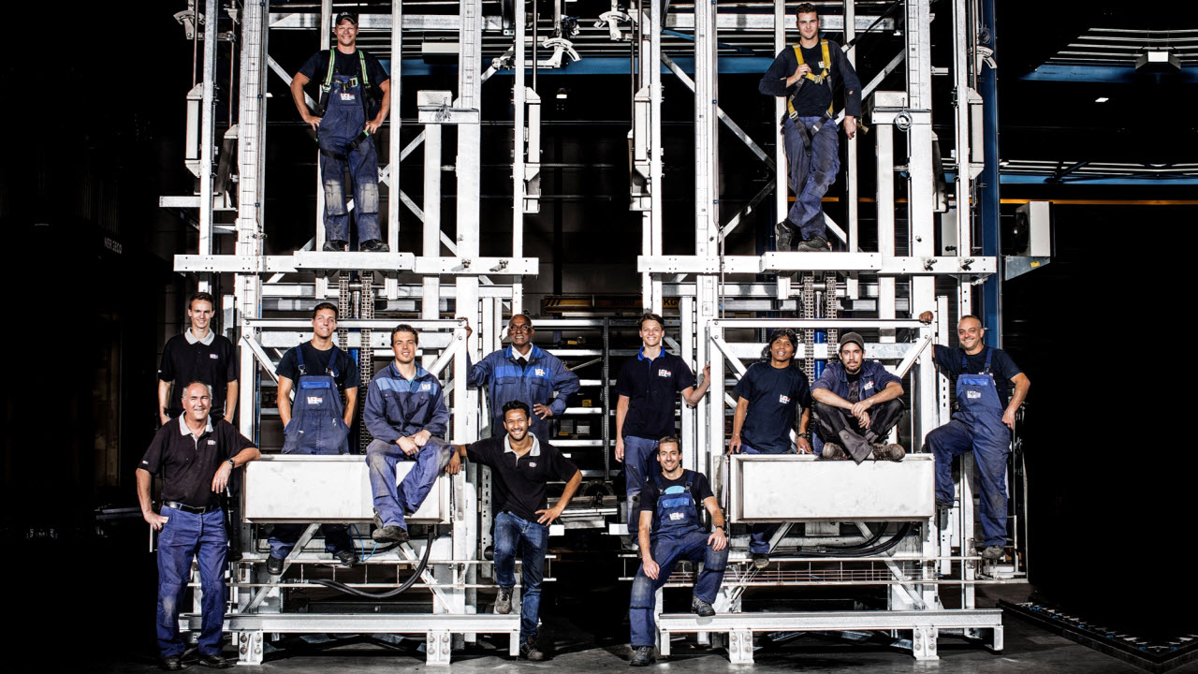

VDL Steelweld
KRACHT DOOR
SAMENWERKING
Strength through cooperation
Process description GTD-E Demonstrator: EST-Floattech
VDL Steelweld, Breda

Slide 2

Change sheet
Revision | Description | Responsible | Date
01 | First edition | VDL STW | 22-04-2022
02 | Template updated | VDL STW | 10-05-2022
03 | Updates after feedback NC | VDL STW | 30-05-2022
04 | Added products, product/material flow, new input | RR | 12-08-2022
05 | Processed feedback + add level 2 & Data logging | RR | 09-09-2022
06 | EST-FT specific +added level 3 content + stack light & button colors + updated figures | RR | 26-01-2023
07 | Edit needed after EST-FT visit, minor changes to manual stations | RR | 02-05-2023

Slide 3
Content Process description
Content:
Introduction
Order process
Safety areas
Warehouse / logistics
Product & material flow
Process overview by station
General
Per product
Supporting processes
Fault handling

Slide 4
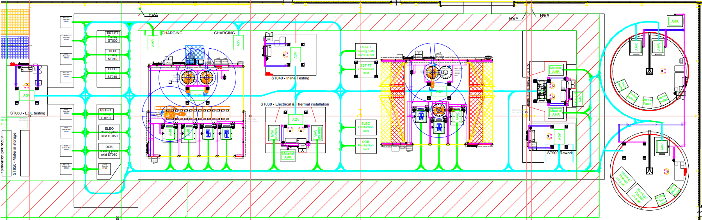
Introduction
The GTD-e demonstrator line will be able to build a great variety of battery packs with minimal re-engineering effort when implementing new products. In this production line there are 2 automated, 4 manual stations, a rework station and a loading station plus warehousing. AGV’s transport the product between the stations and AMR’s transport material and tooling between warehousing and the stations.
The battery pack assembly process
generally is divided in 6 different steps
at the following stations:
ST010 Pack preparation
ST020 Module positioning & mounting
ST030 Electrical & thermal installation
ST040 Inline-testing
ST050 Closing
ST060 End-of-line testing
Additional activities will be
done in the following area’s:
ST900 Rework
ST600 Part preparation (loading/transport,
sub-assemblies and incoming module tests)
4
8
6
5
2
1
3
7
8

Slide 5
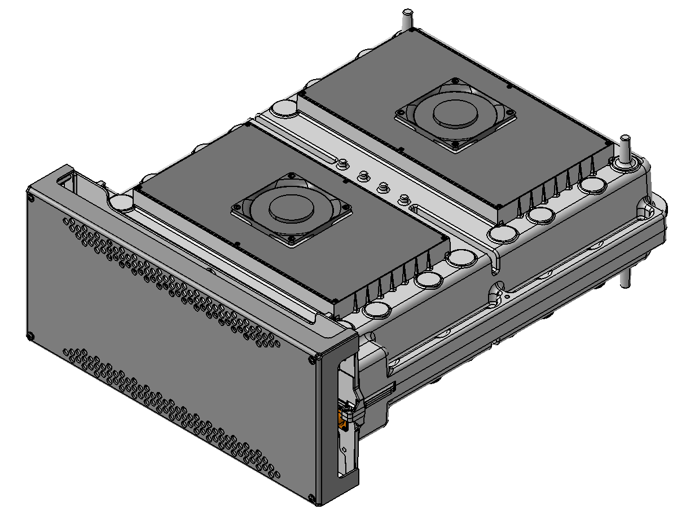
Introduction
The GTD-e demonstrator line will be able to build a great variety of battery packs with minimal re-engineering effort when implementing new products. In P1, the following battery packs are going to be produced on the Battery Assembly Line:
NGC DOB Redesign
EST-Floattech
ELEO
This process description describes the process for the EST-FT pack.
2
EST-FT

Slide 6
Order process & steering concept P1
Order process:
The operator will enter a production schedule (product type + amount + sequence) at the HMI located in the warehouse
Steering concept:
Standard type management will be used to track the main part throughout the line (as described in more detail in the VDL Steelweld standard documentation)
The majority of the type management will be performed in the master PLC and where needed the master PLC will send the needed type information to the slave PLCs
For each possible location of a part a data placeholder will be created (in each fixture or AGV for example). Data can then be created, merged, shifted or deleted in or between these placeholders

Slide 7
Safety Areas: PLC 1 (BAL01 - Master)
Safety Areas BAL01:
BAL01++010 = SA01
BAL01++030 = SA02
BAL01++040 = SA03
BAL01++060 = SA04
BAL01++600 = SA05
BAL01++900 = SA06
3
4
1
2
6
5

Slide 8
Safety Areas: PLC 2 (BAL02)
Safety Areas BAL02:
BAL02++020 = SA01
1

Slide 9
Safety Areas: PLC 3 (BAL03)
Safety Areas BAL03:
BAL03++050 = SA01
1

Slide 10
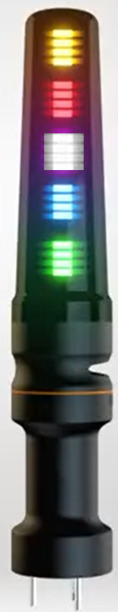
Operator Status Light Colors
Color:
YELLOW – continuous = Operator action required
YELLOW – flashing + acoustic signal= Warning / Moving mechanical part / AGV / Trunnion
RED – continuous = E-stop
RED – flashing + buzzer = Alarm
WHITE – continuous = Cycle finished / Ready for release
WHITE – flashing = Cycle stop requested
BLUE – continuous = Process fault (torque not reached / test failed / adhesive NOK)
GREEN – continuous = Auto running
GREEN – flashing = Not all processes in automatic mode

Slide 11
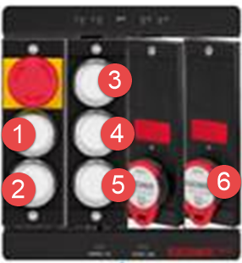
Operator Push-Buttons Colors (automated stations)
Euchner push-button box (3xST020 & 3xST050):
E-stop = red/yellow
Request to enter – white
Reset – Red
Start – Green
Spare (bridge light curtain/scanner)
Spare
Safety tags

Slide 12
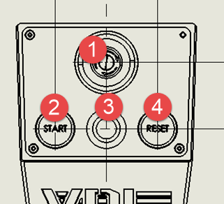
Operator Push-Buttons Colors (manual stations)
VDL push-button panel (2xST010, 2xST030, ST040, ST060, 2xST600 & ST900):
E-stop = Red/Yellow
Start/Stop
Green Solid + “Run” – Run (all EMS in safety area running)
Green Flashing + “----” – Start required (not all ems running)
Red Solid + “Stop” – Stop (all ems in safety area stopped)
If pressed for 3 seconds during run → Stop
If pressed during stop → Start
Release button
Light off – Nothing to indicate
Yellow Flashing – Indicate process step is complete, press to start next process step
Yellow Solid – Indicate process step is ongoing
Blue Flashing – Indicate process step has failed, press to release for pick-up to rework
Blue Solid – Indicate skid is released for pick-up to rework
White Flashing – Indicate all process steps complete, press to release for pick-up
White Solid – Indicate skid is released for pick-up
Reset button
Red Solid + “REL” – E-stop is pressed
Red Flashing “RES” – Reset required
2 hand start buttons
5
5

Slide 13
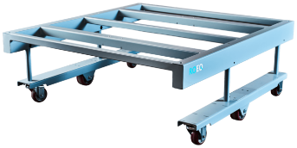
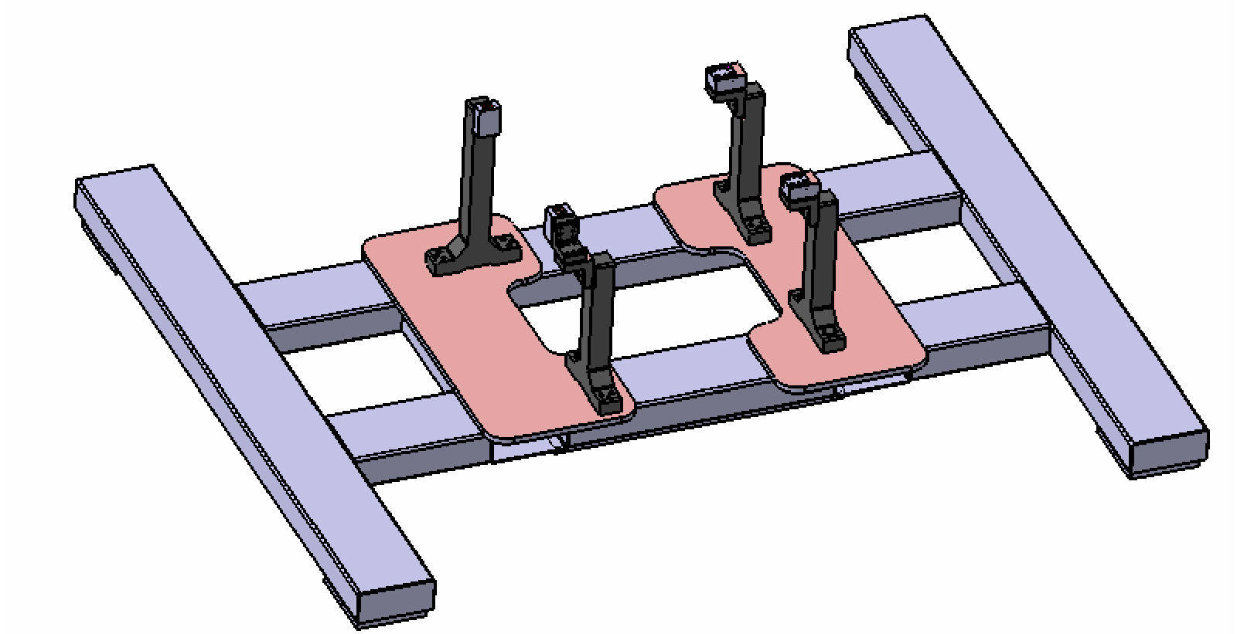
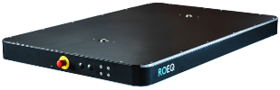
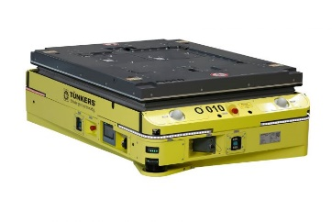
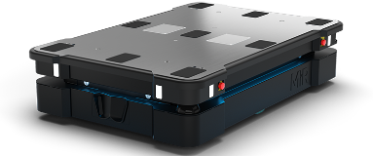
Warehouse / Logistics
At the warehouse the following material is stored:
Battery packs (daily production stock)
Battery modules (daily production stock)
Material
Skids/conveyors:
Production skids (AGV)
Module skids (AMR)
Closing plate skids (AMR)
Tool skids + grippers (AMR)
Material trolleys (AMR)
The AMR/AGV picks up skids and drops them at the loading station, where operators (un)load the skids with the help of JIB-arms
The AMR transports loaded skids, tooling and material trolleys from the warehouse to station on request. Docking station is only required for precise docking.
The AGV transports the product skid throughout the production line. Docking station is always required.
AGV + skid
AMR + skid

Slide 14
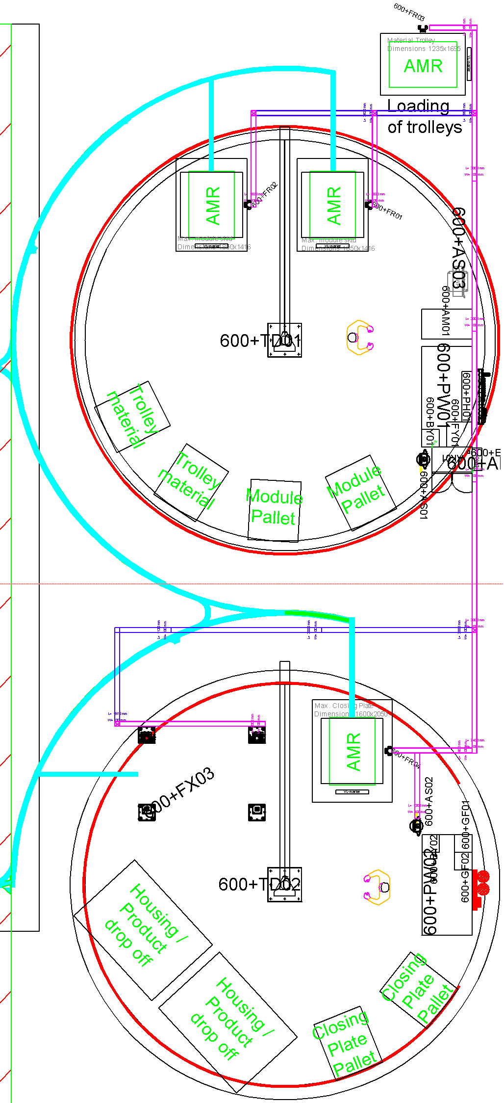
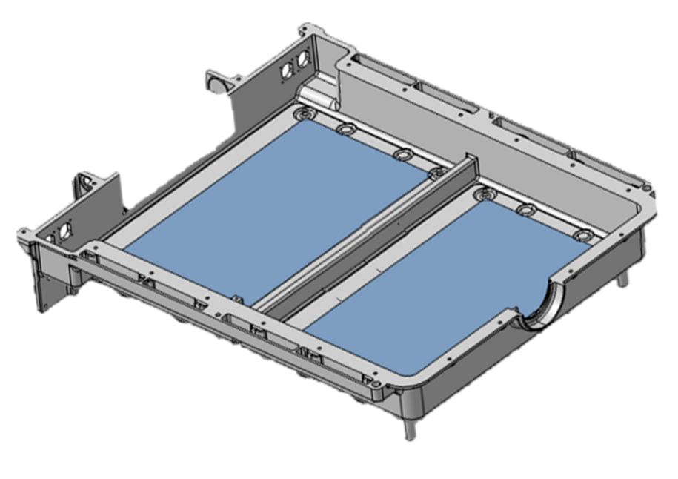
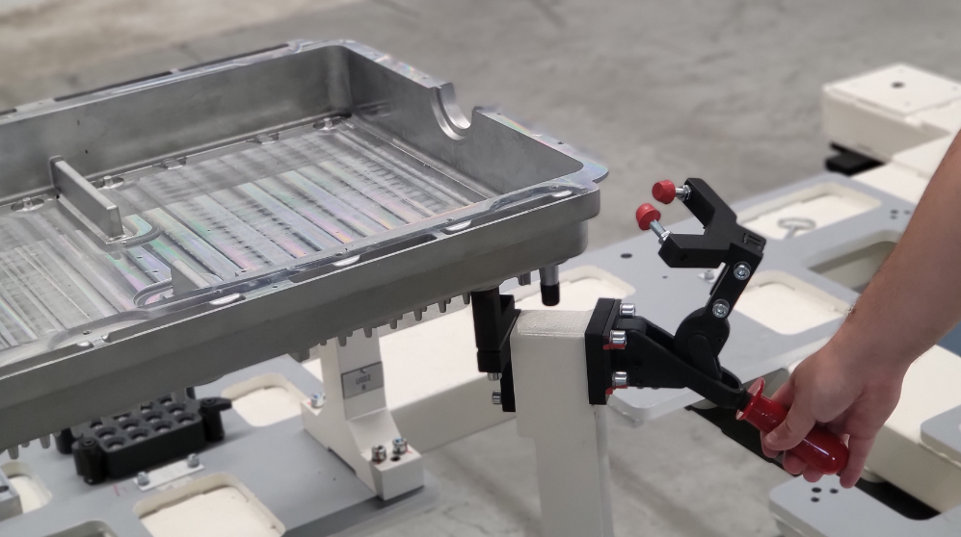
ST600 Part prep: loading of pack bottom housing on AGV’s EST-FT
EST-FT work flow
Operator picks the pack bottom housing from pallets manually and places it on workbench PW02
Operator checks on label (prints a label for the pack housing with printer FY01 if absent and) scans the pack housing with scanner BY02
Operator scans specific tray of fan plates, picks them and mounts them at specified locations and presses release
Operator picks the pack housing from the workbench manually and places it on the product skid at FX03 location and fixes it to the skid
Operator (or cobot P2) prepares the bolting magazine(s) and operator loads them on the product skid
Operator releases the skid for pickup by AGV by pushing the release button
AGV drives into the station, picks up the skid with housing at FX03 and transports it to ST010
7
2
4
5
6
3
1
1

Slide 15
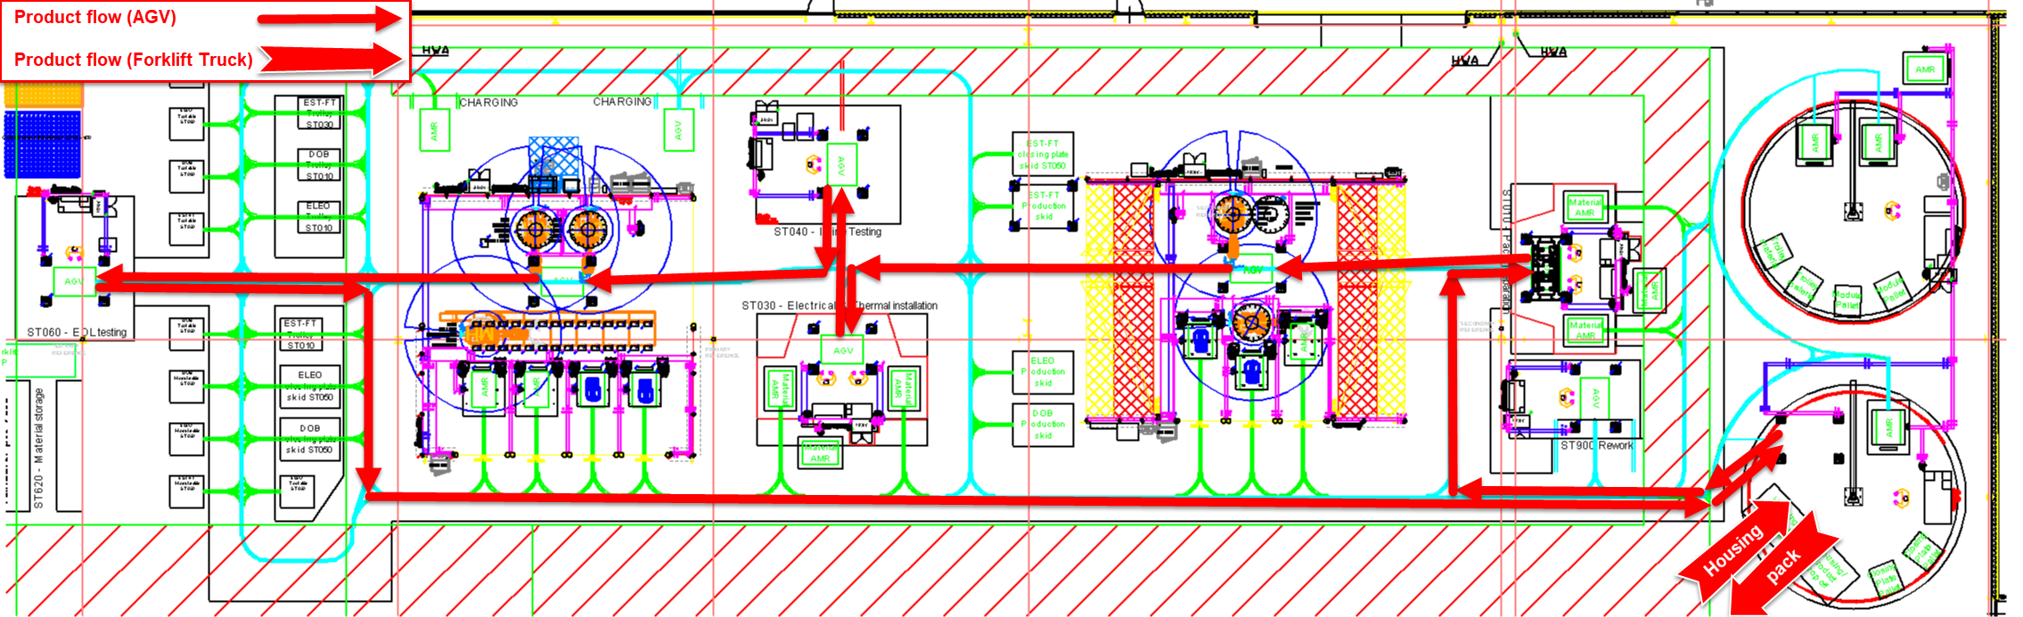
Product flow (AGV)
Product flow
AGV picks up product skid at warehouse:
EST-FT at 630+FX10
Product skid is dropped off at loading station 600+FX03
Product housing is dropped off at loading station ST600 drop-off locations with forklift truck
Housing is lifted on the product skid at 600+FX03 by an operator with lifting aid 600+TD02
AGV picks up loaded product skid at 600+FX03
AGV transports the product through the production line
AGV drops the finished battery pack off at the loading station 600+FX03
Battery pack is unloaded from the product skid at 600+FX03 by an operator with lifting aid 600+TD02 to drop-off location
Battery pack is transported with forklift truck and stored at the pack storage
AGV picks up empty product skid at 600+FX03 and transports it back to its location in the warehouse
1a
1b
1c
2
5
7
10
6
4
8
3
9

Slide 16
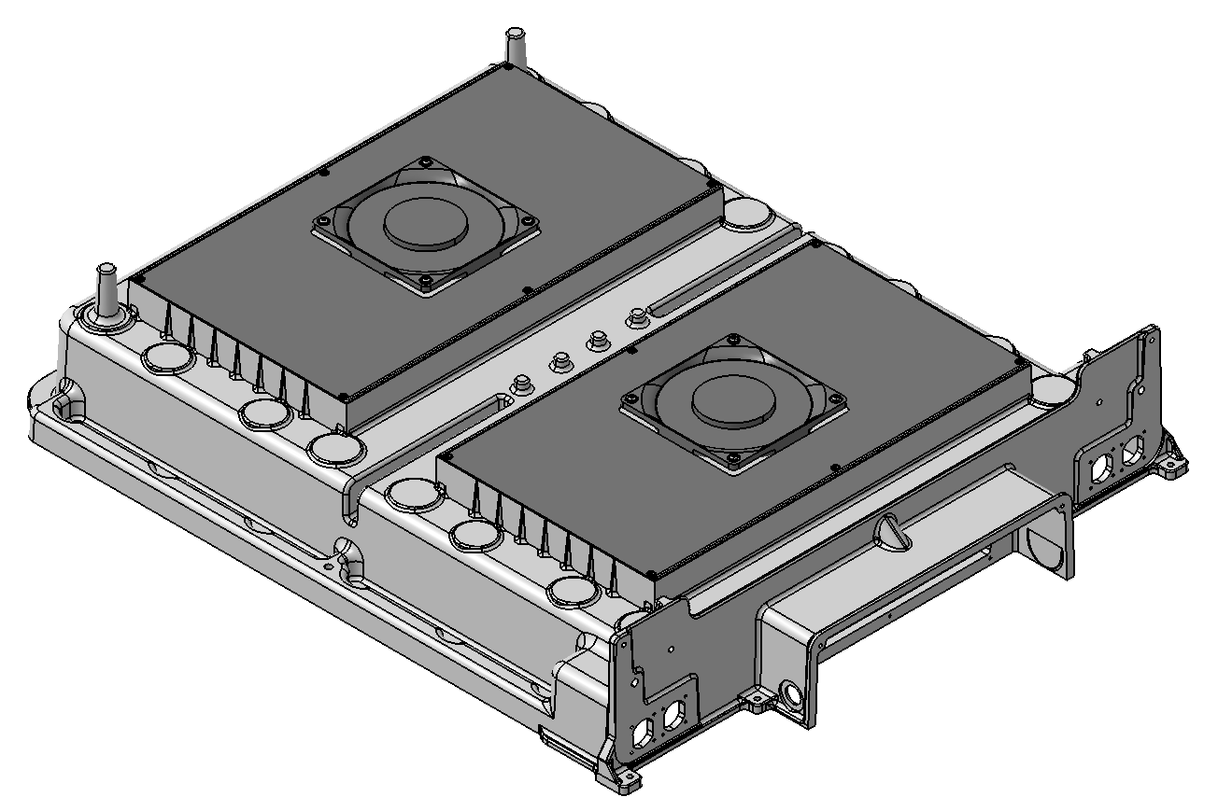
ST600 Part prep: loading of pack housing cover on AGV’s EST-FT
EST-FT work flow
Operator picks the pack housing from pallets manually and places it on workbench PW02
Operator (prints a label for the pack housing with printer FY01 if absent and) scans the pack housing with scanner BY02
Operator scans specific tray of fan plates, picks them and mounts them at specified locations and presses release
2
1
3
1

Slide 17
ST600 Part prep: unloading of pack from AGV’s
Work flow
AGV Transports the battery pack to docking location FX03, docks of the skid and proceeds to the next assignment
Operator scans the battery pack with scanner BY02
Operator picks the pack housing from the skid with the lifting device TD02 and places it on a drop-off location
Operator with forklift truck picks up the battery pack and places it in storage
1
2
3
4
3
4

Slide 18
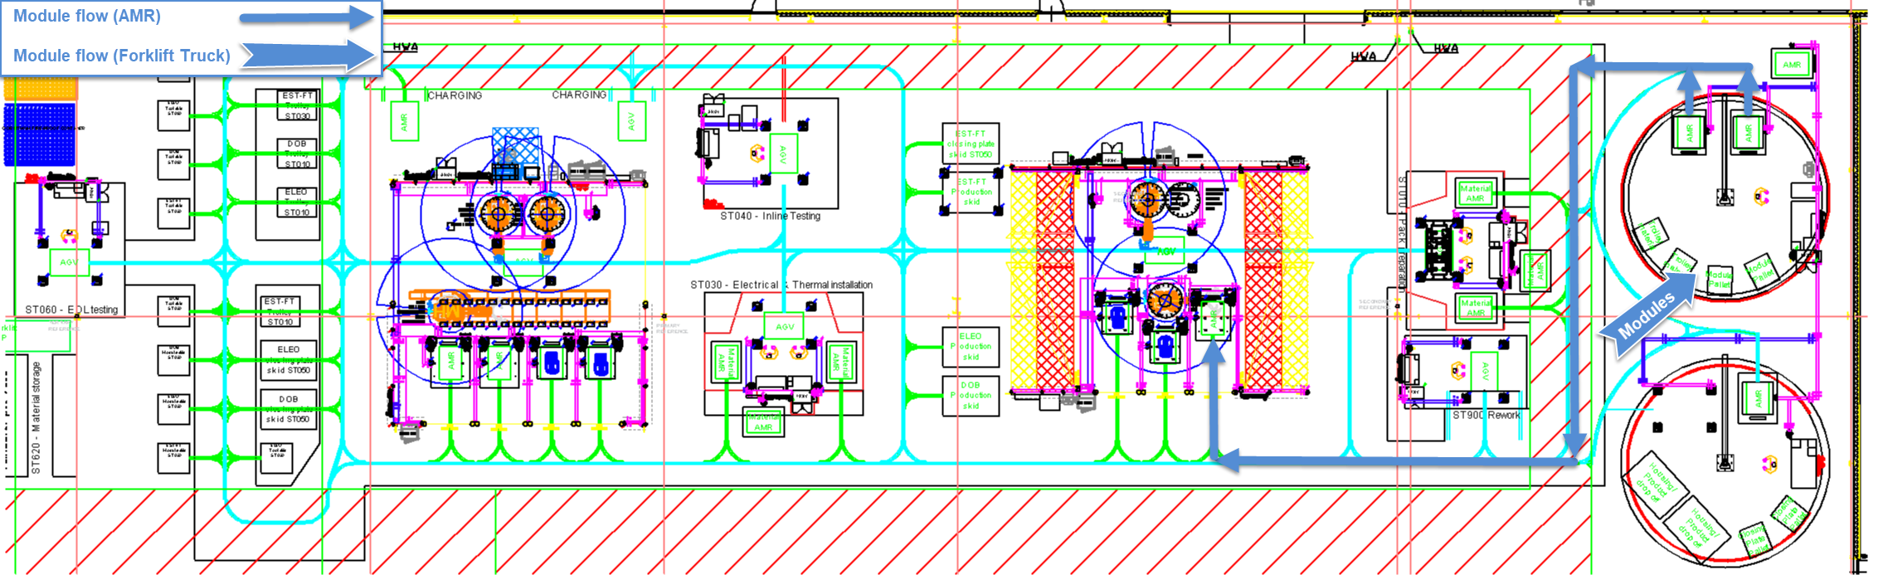
Material flow: Modules (AMR)
Material flow: modules
AMR picks up module skid at warehouse:
EST-FT 610+TC01
AMR drops module skid at 600+FR01 or 600+FR02
Module pallet is dropped off at loading station drop-off locations with forklift truck
Modules are lifted on the workbench PW01 with lifting aid TD01
Incoming tests are performed
Modules are lifted on the module skid at 600+FR01 or 600+FR02 by an operator with lifting aid TD01
AMR picks up loaded module skid at 600+FR01 or 600+FR02
AMR transports the modules to ST020
AMR drops the modules off at 020+FX02
AMR picks up empty module skid and transports it back to its location in the warehouse
2
7
4
6
5
3
9
10
1c
1b
1a
8

Slide 19
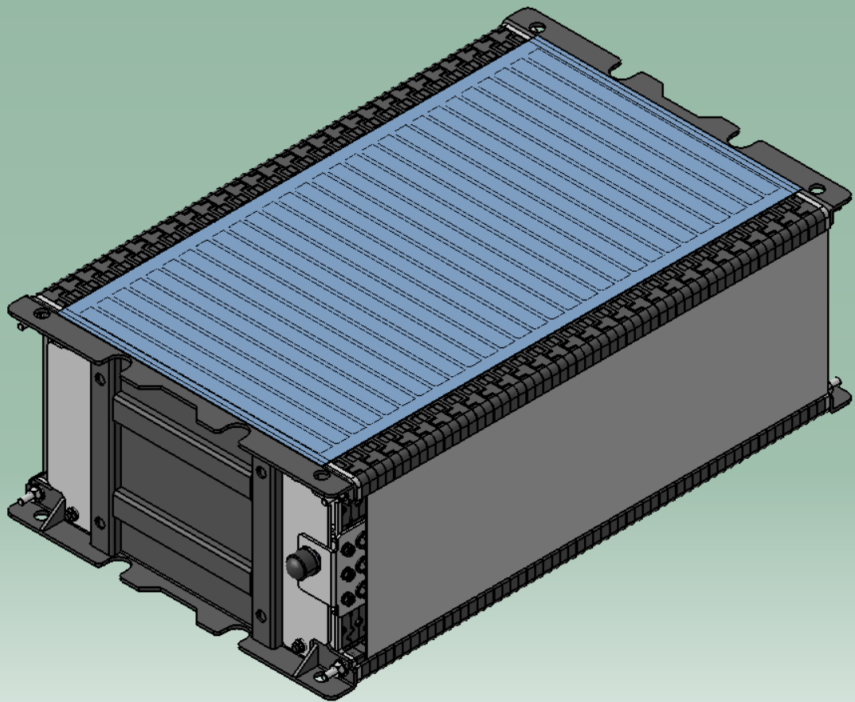
ST600 Part prep: loading of modules on AMR’s
EST-FT
Work flow
Operator picks the incoming modules from pallets with the lifting device TD01 and places them on workbench PW01
Operator scans and tests the modules
Voltage measurement
Insulation measurement
AC-IR measurement
Operator fixates the cables to the module with tape
Operator picks up the modules with the lifting device TD01 and places it on the skid at 600+FR01 or 600+FR02
Operator releases the skid for pickup by AMR by pushing the release button at AS01
AMR drives into the station, picks up the skid with modules at 600+FR01 or 600+FR02 and transports it to ST020
6
6
4
4
5
2
3
1
1
1
1

Slide 20
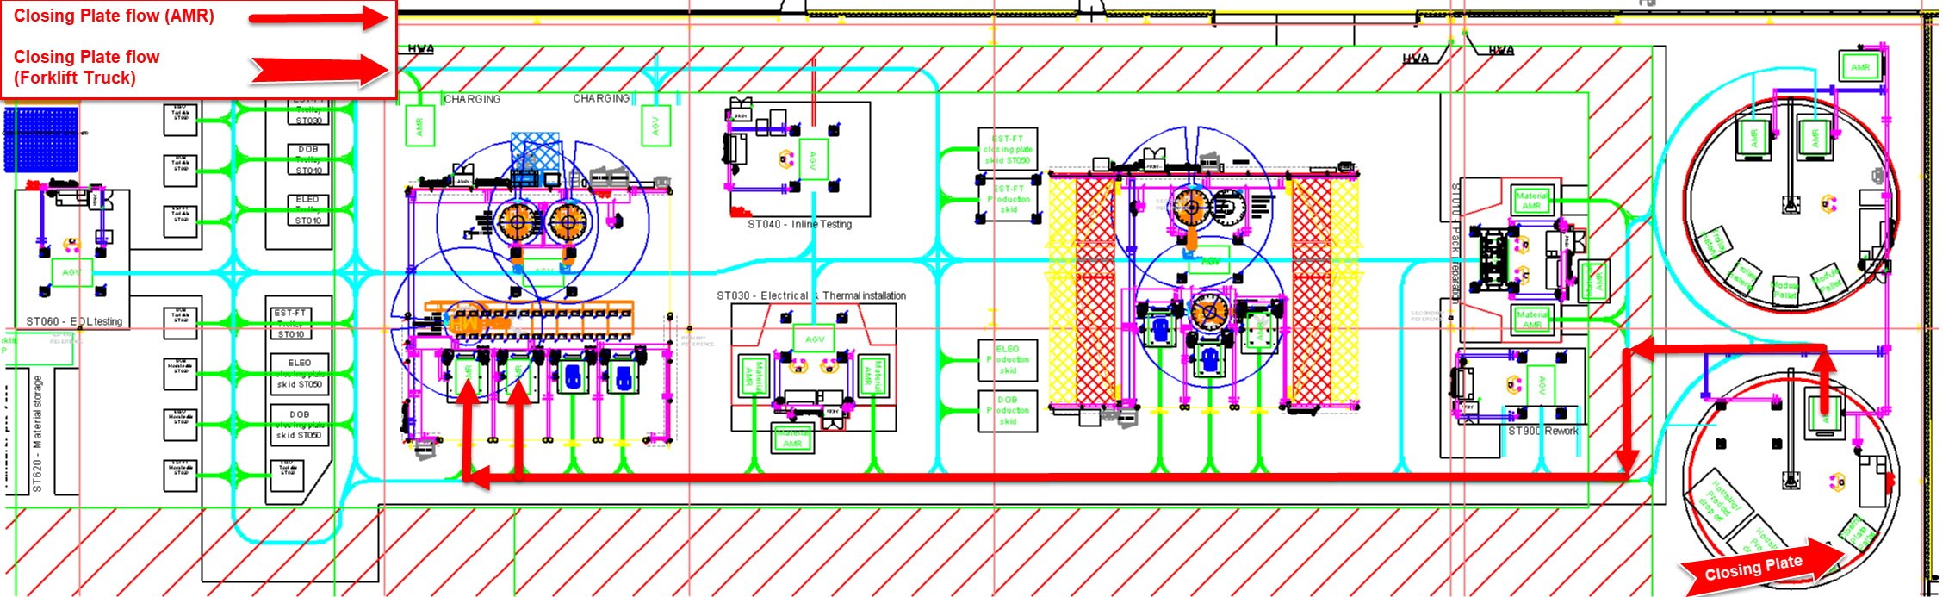
Material flow: Closing plates (AMR)
Material flow: closing plates
AMR picks up closing plate skid at warehouse:
EST-FT 630+TC07
ELEO 630+TC08
DOB 630+TC09
AMR drops closing plate skid at 600+FR04
Closing plate is dropped off at loading station with forklift truck
Closing plate is lifted on the closing plate skid at 600+FR04 by an operator with lifting aid 600+TD02
AMR picks up loaded closing plate skid at 600+FR04
AMR transports the closing plates to ST050
AMR drops the closing plate skid off at 050+FX04/FX05
AMR picks up empty closing plate skid and transports it back to its location in the warehouse
1a
1c
7
8
1b
2
5
6
4
3

Slide 21
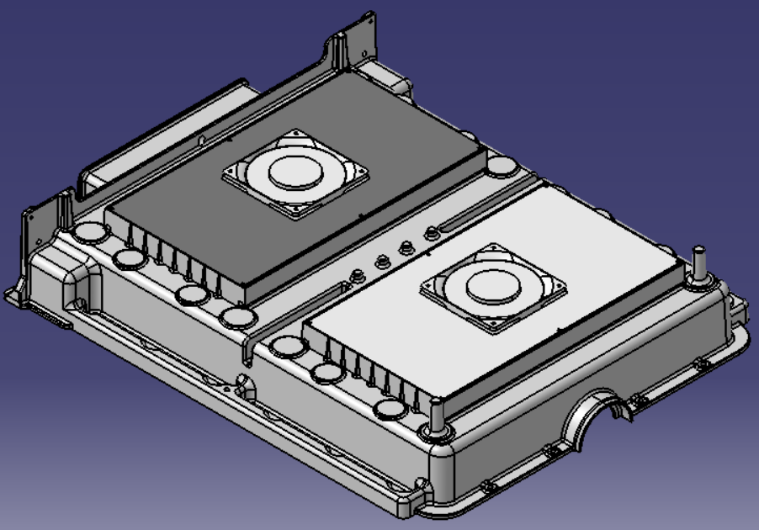
ST600 Part prep: loading of closing plates on AMR’s
EST-FT
EST-FT work flow
Operator picks the closing plate from pallets manually and places it on workbench at PW02 location
Operator scans the closing plate with scanner BY02
Operator scans specific tray of fan plates, picks them and mounts them at specified locations and presses release
3
2
3
1
1
21

Slide 22
ST600 Part prep: loading of closing plates on AMR’s
EST-FT
EST-FT work flow
Operator picks the closing plate from pallets manually and places it on workbench at PW02 location
Operator scans the closing plate with scanner BY02
Operator scans specific tray of fan plates, picks them and mounts them at specified locations and presses release
Operator picks the closing plate from the workbench manually and places it on the closing plate skid at FR04 location
Operator releases the loaded skid at FR04 for pickup by AMR by pushing the release button at AS02
AMR drives into the station, picks up the skid with closing plates at FR04 and transports it to ST050
6
4
5
2
3
1
1

Slide 23
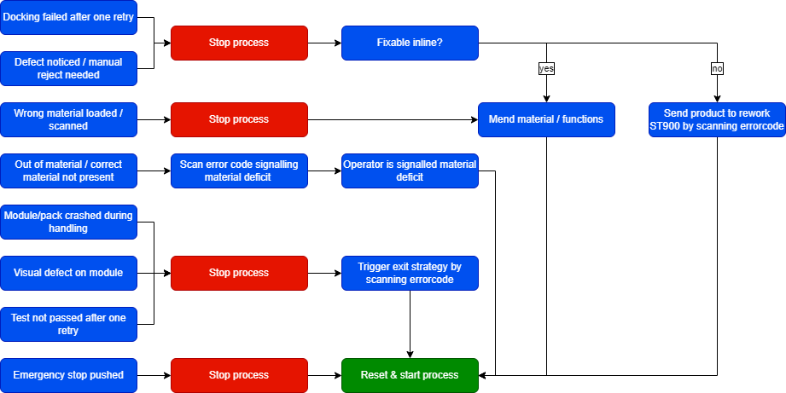
ST600 Part prep: Fault handling

Slide 24
ST600 Data logging
Cycle time logging:
To monitor cycle time, the timestamp will be logged at the following moments:
Skid is docked off
Process step is completed
Skid is released for transport
Skid is loaded
Process data logging:
Main components type and serial number that are scanned and used for subassemblies
All incoming module test parameters and results

Slide 25
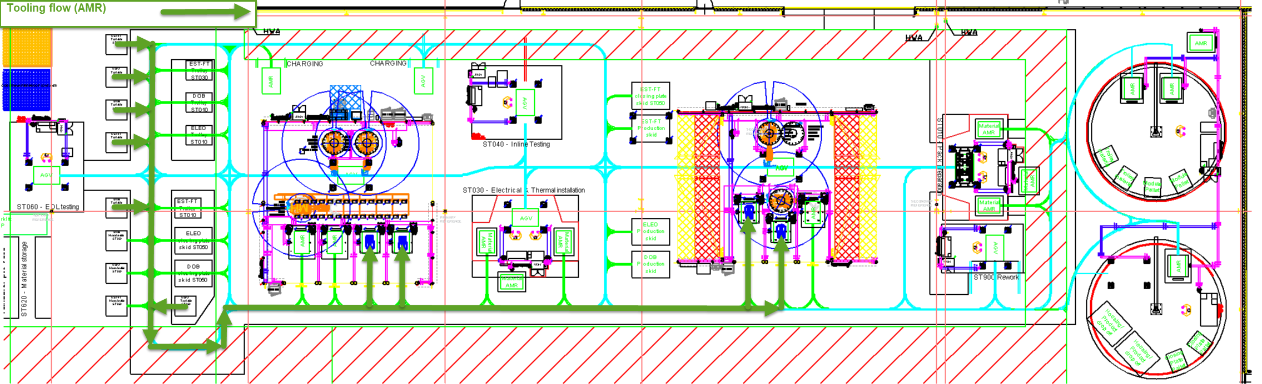
Material flow: Tooling (AMR)
Product flow
AMR picks up tooling skid with tooling at the warehouse:
ST020 tool EST-FT 630+TC01
ST050 tool EST-FT 630+TC04
AMR transports the tooling to ST020 or ST050
AMR drops the tooling off at 020+FX03/FX04 or ST050+FX04/FX05
AMR picks up tooling and transports it back to its location in the warehouse when it is not needed anymore
1b
1a
3
3
3
3
2
4

Slide 26
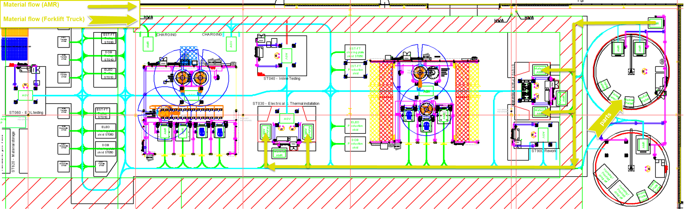
Material flow: Manual parts (AMR)
Product flow
AMR picks up the material trolleys at the warehouse:
ST010 trolley EST-FT 620+TC01
ST030 trolley EST-FT 620+TC04
AMR drops material trolley at 600+FR03
Material is supplied to ST600
Material trolley is loaded fully with exact amount of parts to construct a specified number of packs
AMR transports the material trolleys to ST010 or ST030
AMR goes to 010/030+FR01 RFID to confirm material type + amount
AMR drops off material trolley at ST010 or ST030 position 1 or 2
AMR goes to 010/030+FR01 RFID to reduce product counter on RFID
P1: At end of a produced batch, move material cart from station back to storage
2
4
1b
5
7
6
8
1a
7
7
7
3
6
8

Slide 27
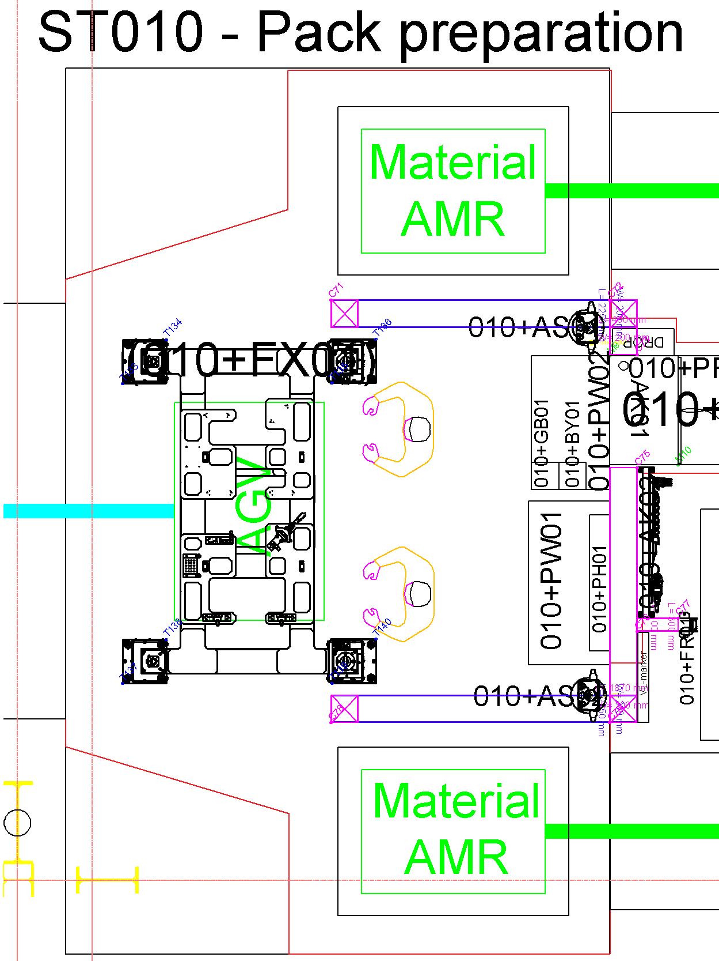
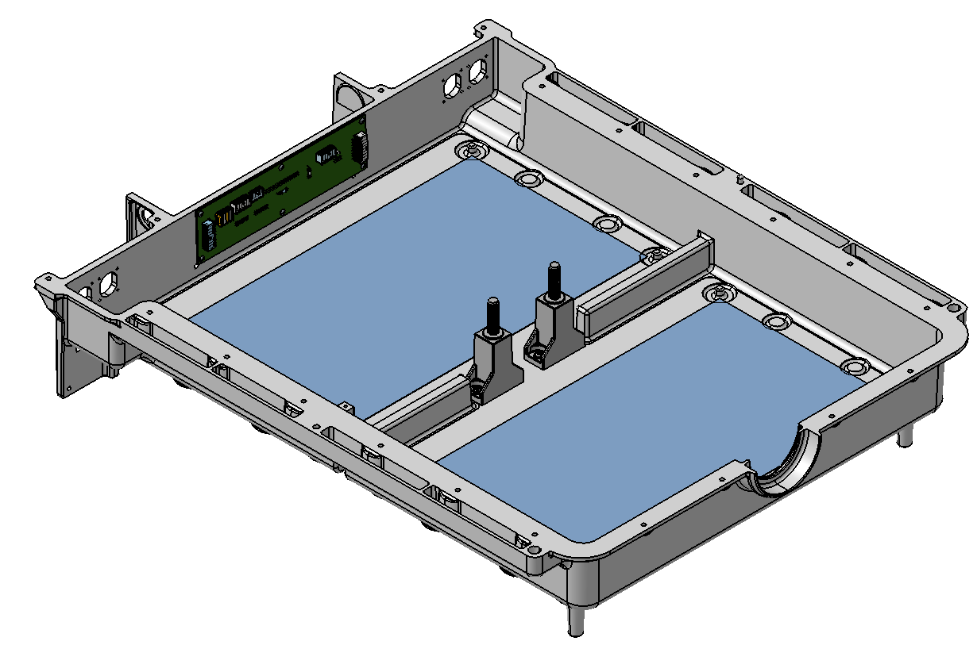
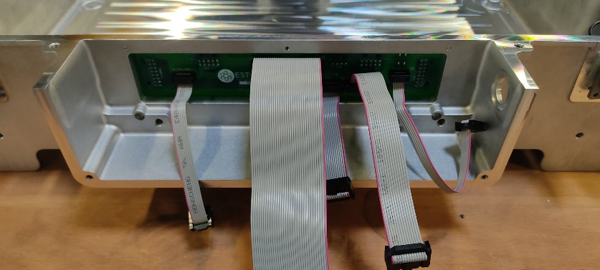
ST010 Pack preparation EST-FT
EST-FT work flow
AGV transports the battery pack housing to the work location, docks of the skid with housing at FX01 and proceeds to the next assignment
The battery pack type is identified with scanner BY01 and work instruction is loaded on the information screen
Operator scans tray of PCB plates, picks 1 and mounts it at specified location with 6 TORX M3x8mm screws
3
3
4
2
1
3
4
3Nm Torx M3

Slide 28
ST010 Pack preparation EST-FT
EST-FT work flow
AGV transports the battery pack housing to the work location, docks of the skid with housing at FX01 and proceeds to the next assignment
The battery pack type is identified with scanner BY01 and work instruction is loaded on the information screen
Operator scans tray of PCB plates, picks 1 and mounts it at specified location with 6 TORX M3x8mm screws
Operator scans tray of Fuse Holders, picks them (2 pcs.) and mounts them at specified locations with 4 TORX M5x12
4
3
4
2
1
3
4
3Nm Torx M5

Slide 29
ST010 Pack preparation EST-FT
EST-FT work flow
AGV transports the battery pack housing to the work location, docks of the skid with housing at FX01 and proceeds to the next assignment
The battery pack type is identified with scanner BY01 and work instruction is loaded on the information screen
Operator scans tray of PCB plates, picks 1 and mounts it at specified location
Operator scans tray of Fuse Holders, picks them (2 pcs.) and mounts them at specified locations with 4 TORX M5x12
Quality check for the applied work
Operators release the skid for pickup by AGV by pushing the release buttons
AGV drives into the station, picks up the skid at FX01 and transports battery pack to the next station
3
4
5
7
8
2
6
1
7
3
4
5

Slide 30
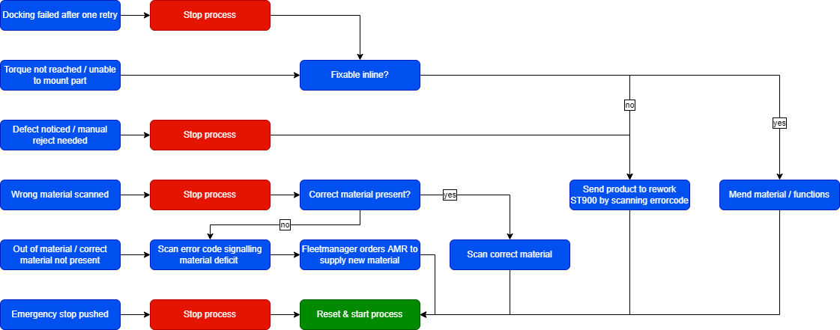
ST010 Fault handling

Slide 31
ST010 Data logging
Cycle time logging:
To monitor cycle time, the timestamp will be logged at the following moments:
Skid is docked off
Process step is completed
Skid is released for transport
Skid is loaded
Process data logging:
Main components type and serial number that are scanned and used for assembly
Tightening action parameters:
Screw type
Number in sequence (corresponding with specific location)
OK/NOK
Torque profile
Speed profile

Slide 32
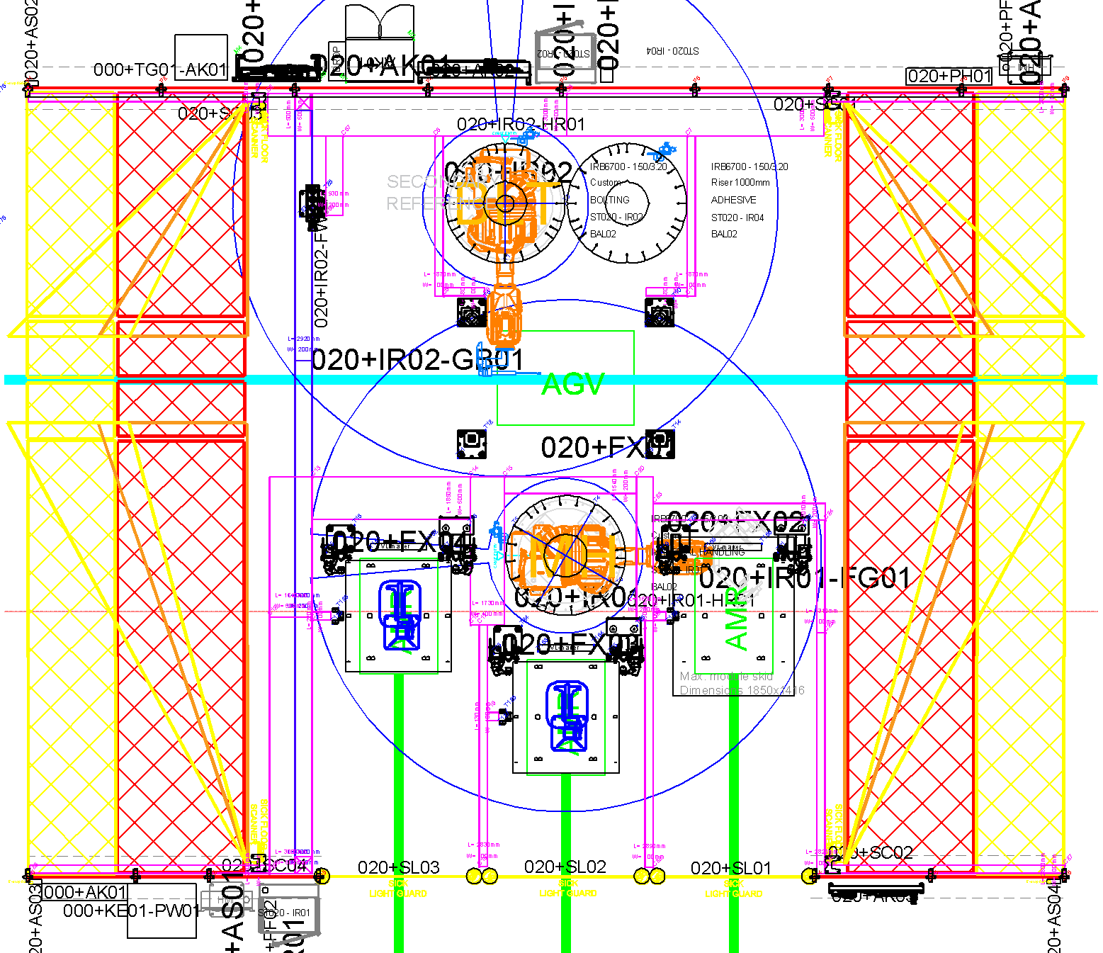
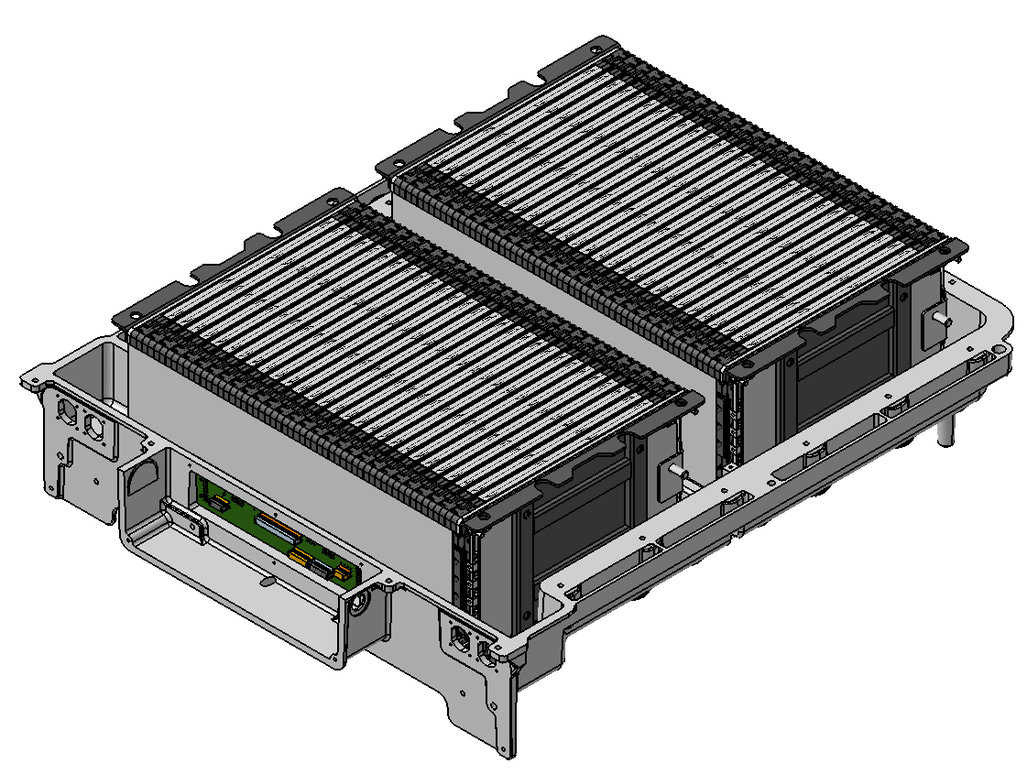
ST020 Module positioning & mounting EST-FT
EST-FT work flow
AGV Transports the battery pack housing to the work location, docks of the skid at FX01 and proceeds to the next assignment
The battery pack is identified and battery pack program is loaded
010R01 makes a thermal image of the modules with IR camera above the module skid
010R01 uses a camera to check if all modules are there, precisely locates the modules at material position FX02, picks modules and scans module QR-code. After this, the bottom of the module is checked with a fixed camera, the position of the battery pack housing is determined and the modules are placed (x2) (No fasteners needed)
010R01 makes a thermal image of the pack with IR camera
AGV drives into the station, picks up the skid at FX01 and transports battery pack to the next station
6
2
1
5
4
4
3

Slide 33
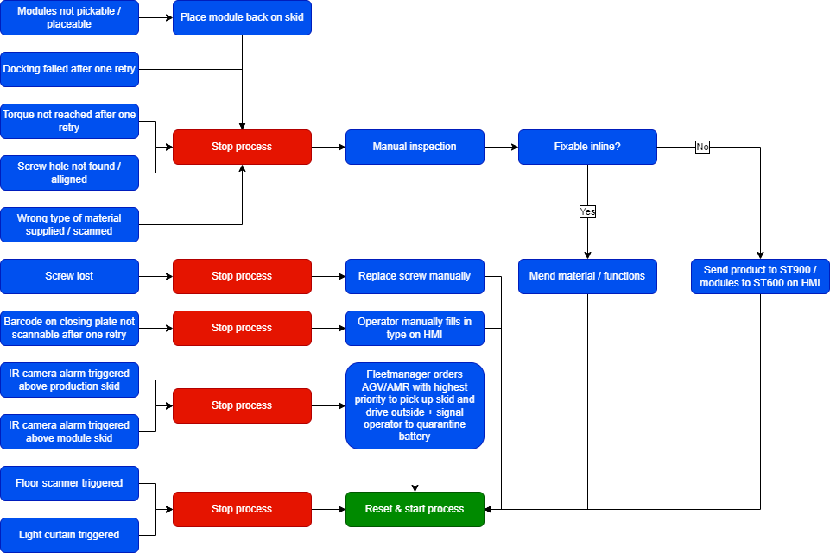
ST020 Fault handling

Slide 34
ST020 Data logging
Cycle time logging:
To monitor cycle time, the timestamp will be logged at the following moments:
Skid is docked off
Process step is completed
Skid is released for transport
Skid is loaded
Process data logging:
Modules:
Type and serial number that are scanned
Thermal data per module from IR snapshots
Tightening action parameters:
Screw type
Number in sequence (corresponding with specific location)
OK/NOK
Torque profile
Speed profile
Depth
Location + quality of holes from camera data (+ NOK pictures?)

Slide 35
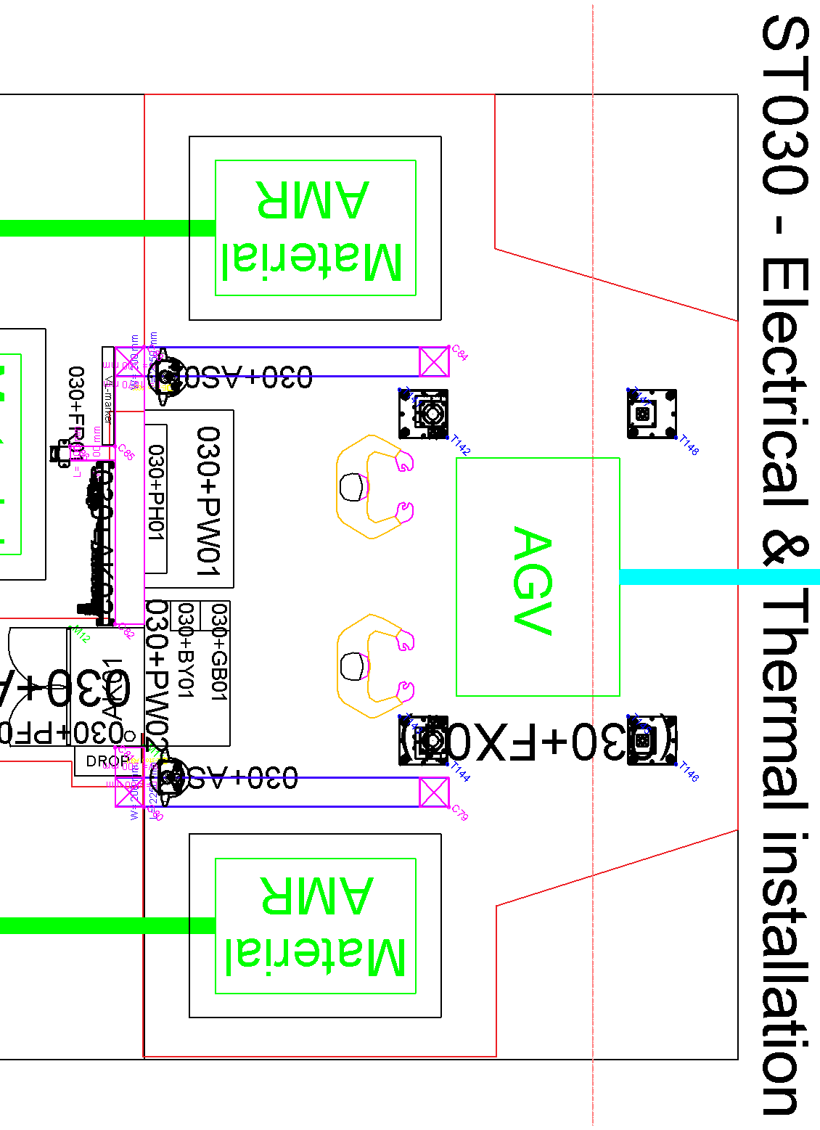
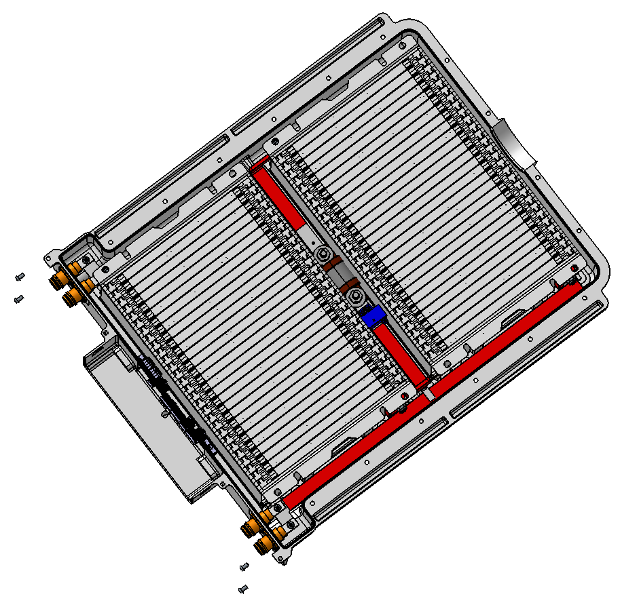
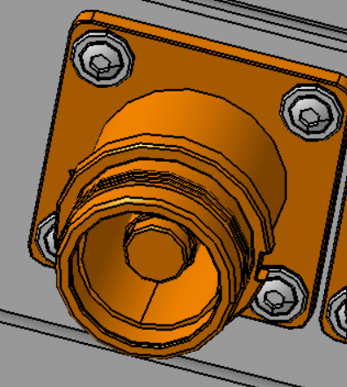
ST030 Electric & thermal installation EST-FT
EST-FT work flow
AGV Transports the battery pack housing to the work location, docks of the skid at FX01 and proceeds to the next assignment
The battery pack type is identified with scanner BY01, work instruction is loaded on the information screen and thermal image is made with IR camera
Operator scans tray and picks 2 connectors and 2 plugs and mounts them at specified locations (receptacles closest to the center of the module, 38cm wire on the left, 22cm wire on the right, use 4 TORX M3x8 screws)
3
3
1
2
3
3Nm Torx M3

Slide 36
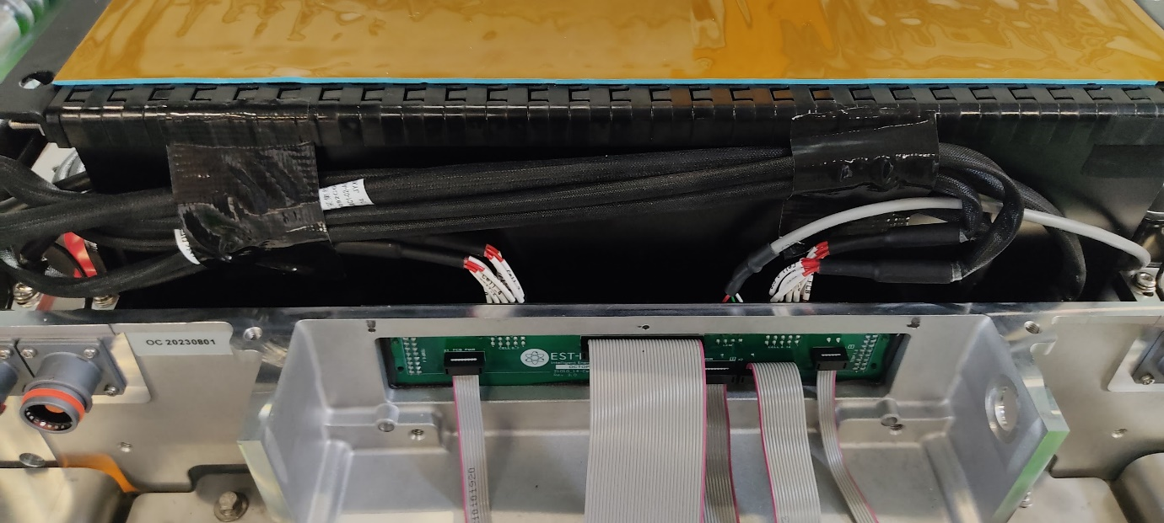
ST030 Electric & thermal installation EST-FT
EST-FT work flow
AGV Transports the battery pack housing to the work location, docks of the skid at FX01 and proceeds to the next assignment
The battery pack type is identified with scanner BY01, work instruction is loaded on the information screen and thermal image is made with IR camera
Operator scans tray and picks 2 connectors and 2 plugs and mounts them at specified locations.
Operator connects wireharness from the modules to the cell interconnect board (2x)
Operator scans trays of busbars, picks the parts, mounts them at specified location
(First the negative black busbar, then red intermediate busbar+wire, then red positive busbar, then other intermediate busbar
5
3
4
5
4
1
2
3
4
5
6Nm Torx M5
10Nm Nut M8

Slide 37
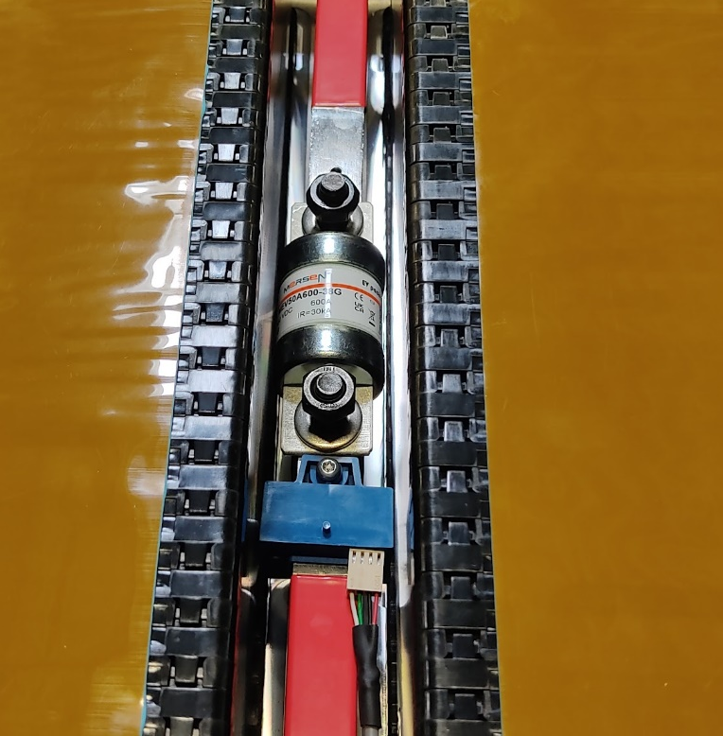
ST030 Electric & thermal installation EST-FT
EST-FT work flow
AGV Transports the battery pack housing to the work location, docks of the skid at FX01 and proceeds to the next assignment
The battery pack type is identified with scanner BY01, work instruction is loaded on the information screen and thermal image is made with IR camera
Operator scans tray and picks 2 connectors and 2 plugs and mounts them at specified locations
Operator connects wireharness from the modules to the cell interconnect board (2x)
Operator scans trays of busbars, picks the parts, mounts them at specified location
Operator scans trays of fuse, picks the parts and mounts them at specified location
3
4
5
6
6
1
2
3
4
5
6
6.8Nm Nut M10

Slide 38
ST030 Electric & thermal installation EST-FT
EST-FT work flow
AGV Transports the battery pack housing to the work location, docks of the skid at FX01 and proceeds to the next assignment
The battery pack type is identified with scanner BY01, work instruction is loaded on the information screen and thermal image is made with IR camera
Operator scans tray and picks 2 connectors and 2 plugs and mounts them at specified locations
Operator connects wireharness from the modules to the cell interconnect board (2x)
Operator scans trays of busbars, picks the parts, mounts them at specified location
Operator scans trays of fuse, picks the parts and mounts them at specified location
Thermal image is made with IR camera and operator does a last quality check for the applied work
Operators release the skid for pickup by AGV by pushing the release buttons or if NOK scans error barcode. Small repairs will be done in the station and large repairs in the rework station.
AGV drives into the station, picks up the skid at FX01 and transports battery pack to the next station
3
4
5
6
8
1
7
2
9
8
3
4
5
6

Slide 39
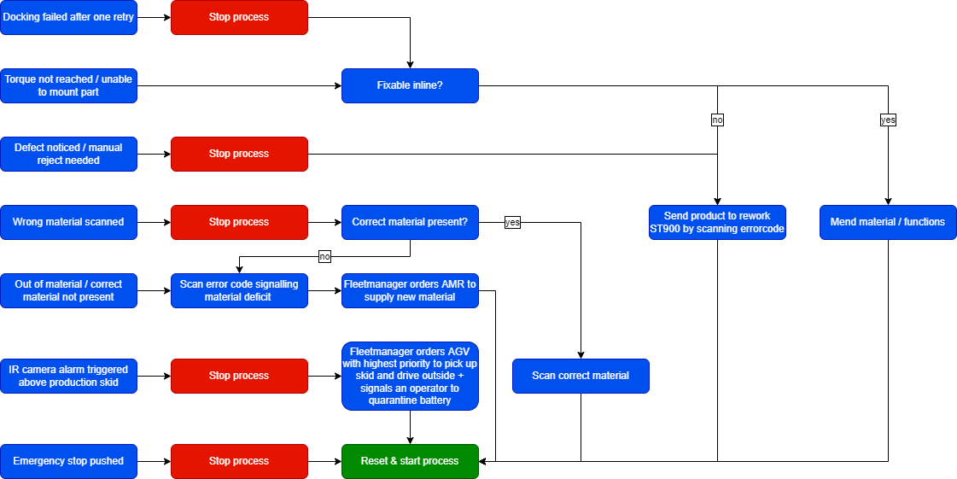
ST030 Fault handling

Slide 40
ST030 Data logging
Cycle time logging:
To monitor cycle time, the timestamp will be logged at the following moments:
Skid is docked off
Process step is completed
Skid is released for transport
Skid is loaded
Process data logging:
Main components type and serial number that are scanned and used for assembly
Thermal data per module from IR snapshots
Tightening action parameters:
Screw type
Number in sequence (corresponding with specific location)
OK/NOK
Torque profile
Speed profile

Slide 41
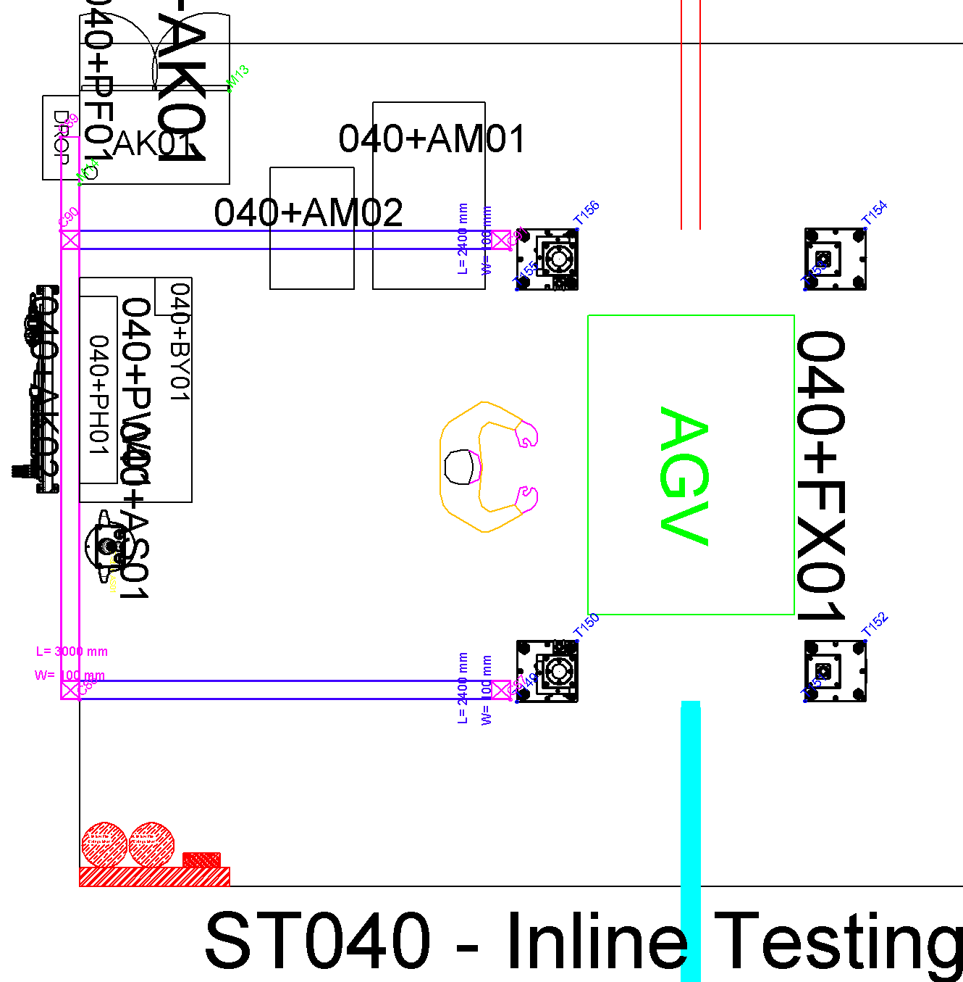
ST040 Inline testing EST-FT
EST-FT work flow
AGV Transports the battery pack housing to the work location, docks of the skid at FX01 and proceeds to the next assignment
The battery pack type is identified with scanner BY01 and work instruction is loaded on the information screen
Operator connects the test equipment for the E-tests and initiates the test program as described.
Voltage measurement
Insulation measurement
BMS/AUX test
Charge-discharge test
If all test results OK, test equipment is disconnected and operator presses release
Pre-closing visual check is done by operator
Operators release the skid for pickup by AGV by pushing the release buttons or if NOK scans error barcode. Small repairs will be done in the station and large repairs in the rework station.
AGV drives into the station, picks up the skid at FX01 and transports battery pack to the next station
3
4
2
5
6
1
7

Slide 42
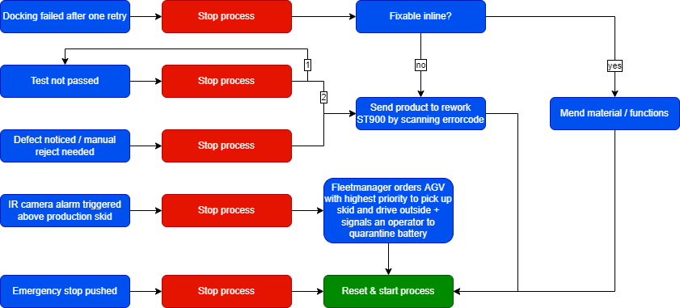
ST040 Fault handling

Slide 43
ST040 Data logging
Cycle time logging:
To monitor cycle time, the timestamp will be logged at the following moments:
Skid is docked off
Process step is completed
Skid is released for transport
Skid is loaded
Process data logging:
Thermal data per module from IR snapshots
All test parameters and results

Slide 44
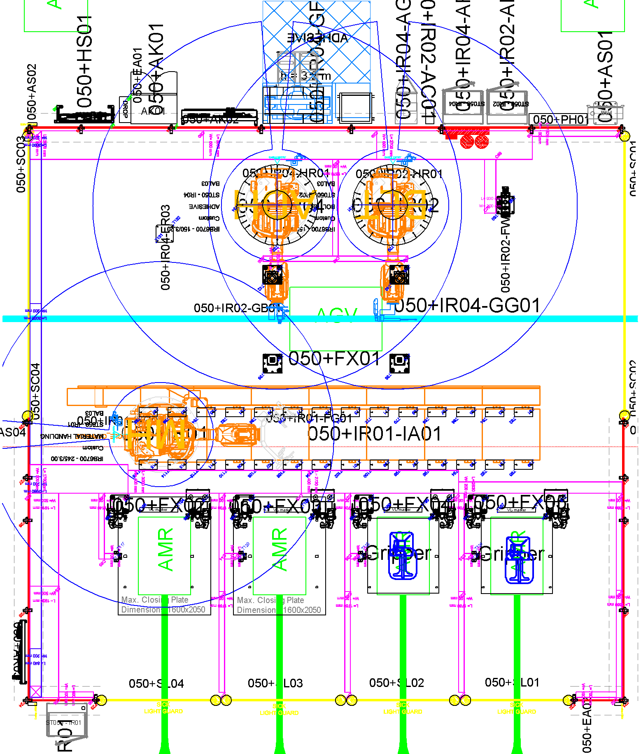
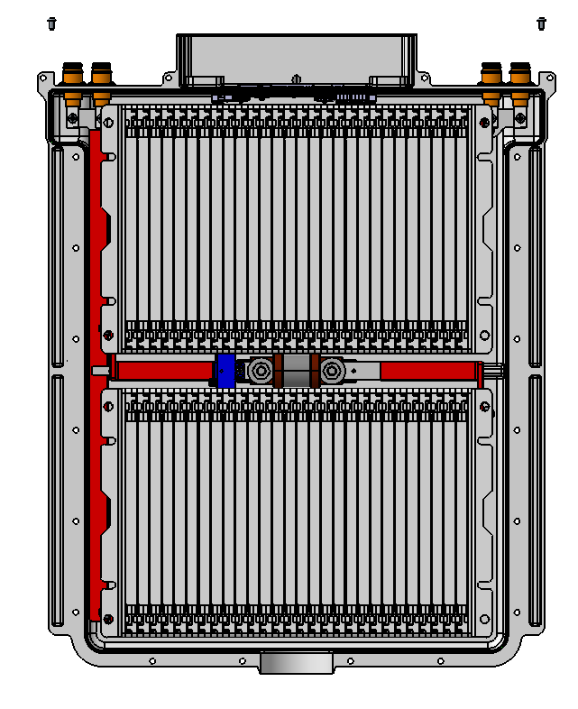

ST050 Closing EST-FT
EST-FT work flow
AGV Transports the battery pack housing to the work location, docks of the skid at FX01 and proceeds to the next assignment
The battery pack is identified and battery pack program is loaded
The battery pack will be scanned 2d to verify the position
050IR01 will present the closing plate and 050IR04 will apply the sealant to the closing plate
4
2
3
1
4

Slide 45
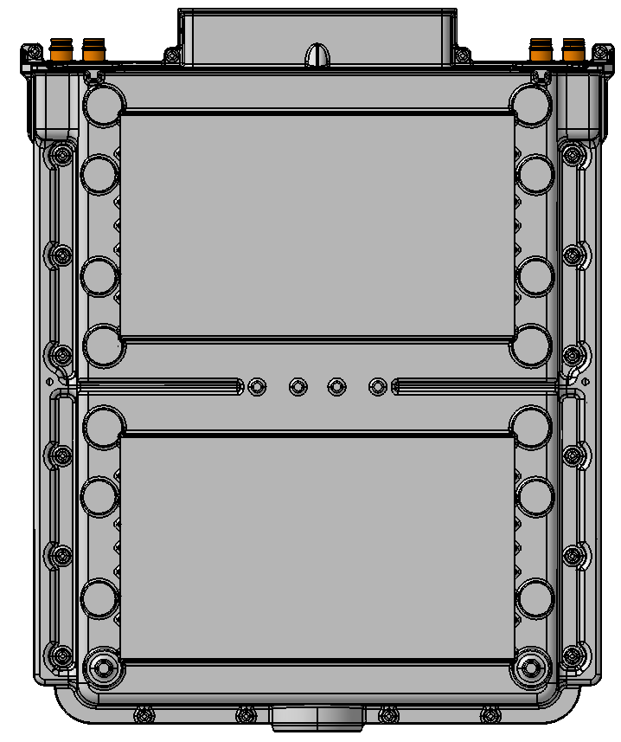
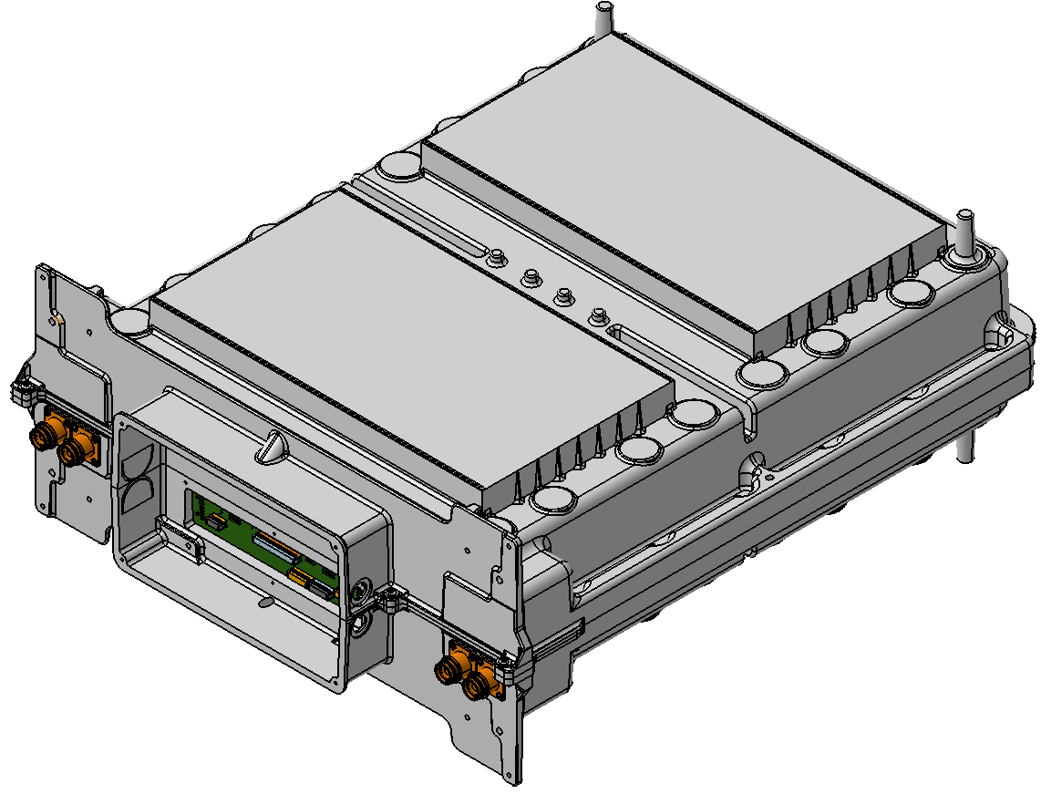
ST050 Closing EST-FT
EST-FT work flow
AGV Transports the battery pack housing to the work location, docks of the skid at FX01 and proceeds to the next assignment
The battery pack is identified and battery pack program is loaded
The battery pack will be scanned 2d to verify the position
050IR01 will present the closing plate and 050IR04 will apply the sealant to the closing plate
050IR01 will place the closing plate on the battery pack
050IR02 will apply 20 bolts to fix the cover (first two with closing plate held in place by 050IR01
AGV drives into the station, picks up the skid at FX01 and transports battery pack to the next station
4
6
7
2
3
1
5
6

Slide 46
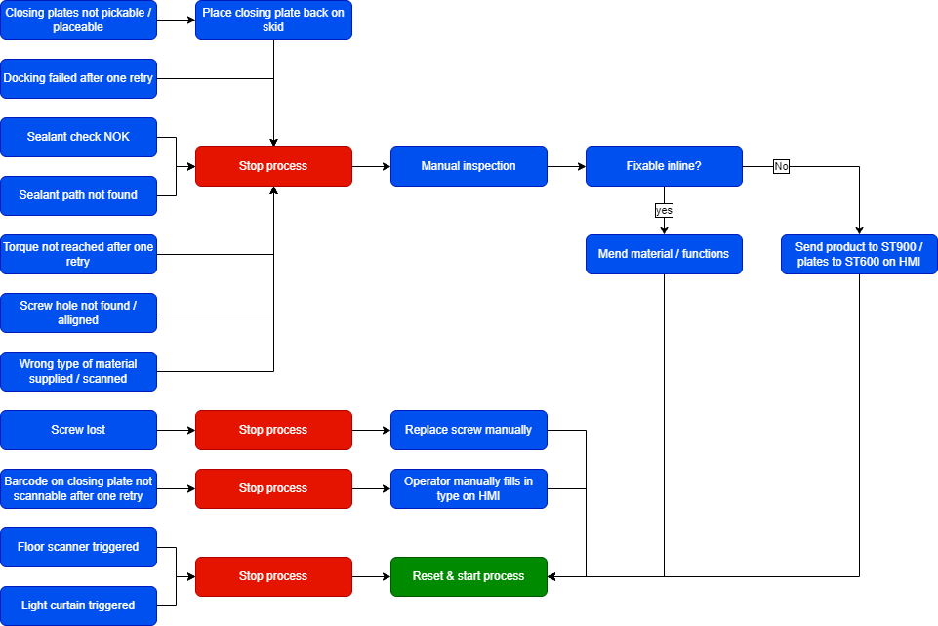
ST050 Fault handling

Slide 47
ST050 Data logging
Cycle time logging:
To monitor cycle time, the timestamp will be logged at the following moments:
Skid is docked off
Process step is completed
Skid is released for transport
Skid is loaded
Process data logging:
Tightening action parameters:
Screw type
Number in sequence (corresponding with specific location)
OK/NOK
Torque profile
Speed profile
Depth
Location + quality of holes from camera data (+ NOK pictures?)
Adhesives action parameters:
Location profile
Speed profile
Material type
Material flow
Material volume

Slide 48
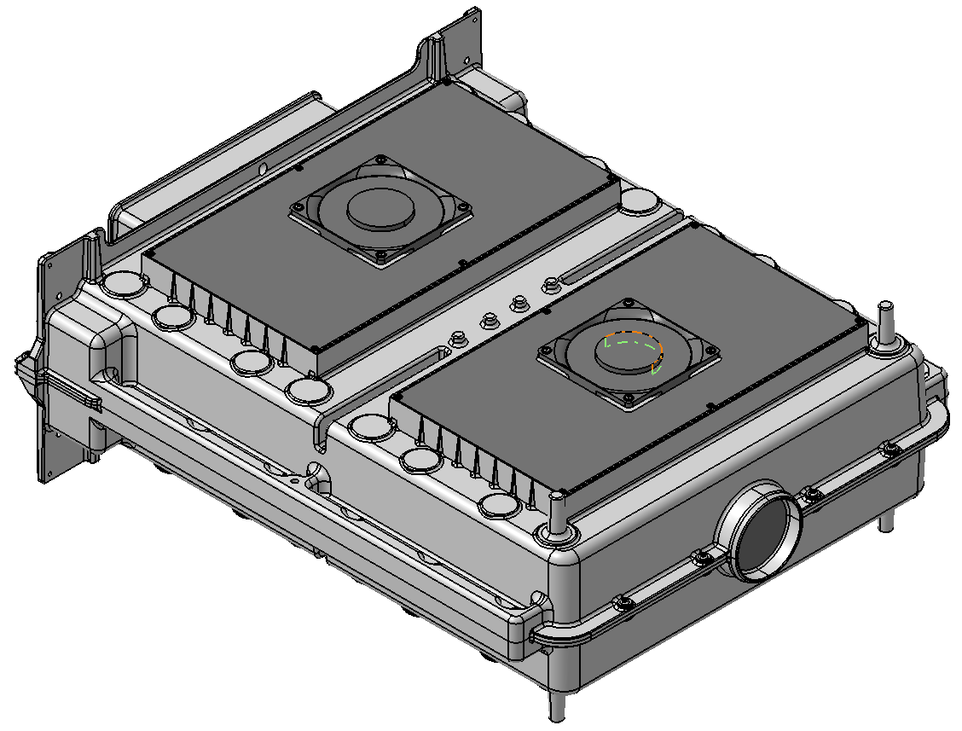
EST-FT REROUTE to ST010/ST030 after ST050
REROUTE BACK TO ST010/ST030 after ST050 for final assembly steps
EST-FT work flow
AGV Transports the battery pack housing to the work location, docks of the skid at FX01 and proceeds to the next assignment
The battery pack type is identified with scanner BY01 and work instruction is loaded on the information screen
Operator scans tray of exhaust cover, picks the part, and mounts it at specified location
3
3
2
1
3

Slide 49
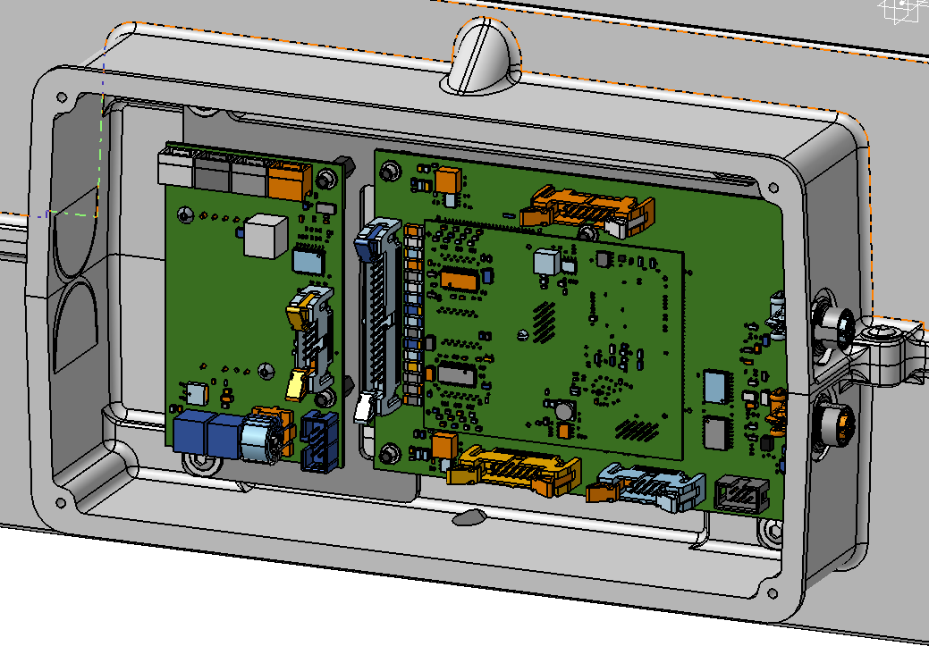
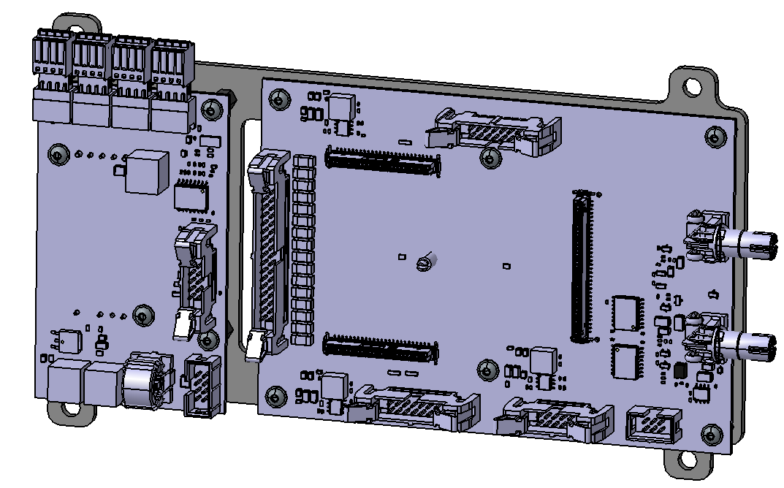
EST-FT REROUTE to ST010/ST030 after ST050
REROUTE BACK TO ST010/ST030 after ST050 for final assembly steps
EST-FT work flow
AGV Transports the battery pack housing to the work location, docks of the skid at FX01 and proceeds to the next assignment
The battery pack type is identified with scanner BY01 and work instruction is loaded on the information screen
Operator scans tray of exhaust cover, picks the part, and mounts it at specified location
Operator scans tray of PCB bracket sub-assy, picks the part, and mounts it at specified location
3
4
4
2
1
3
4

Slide 50
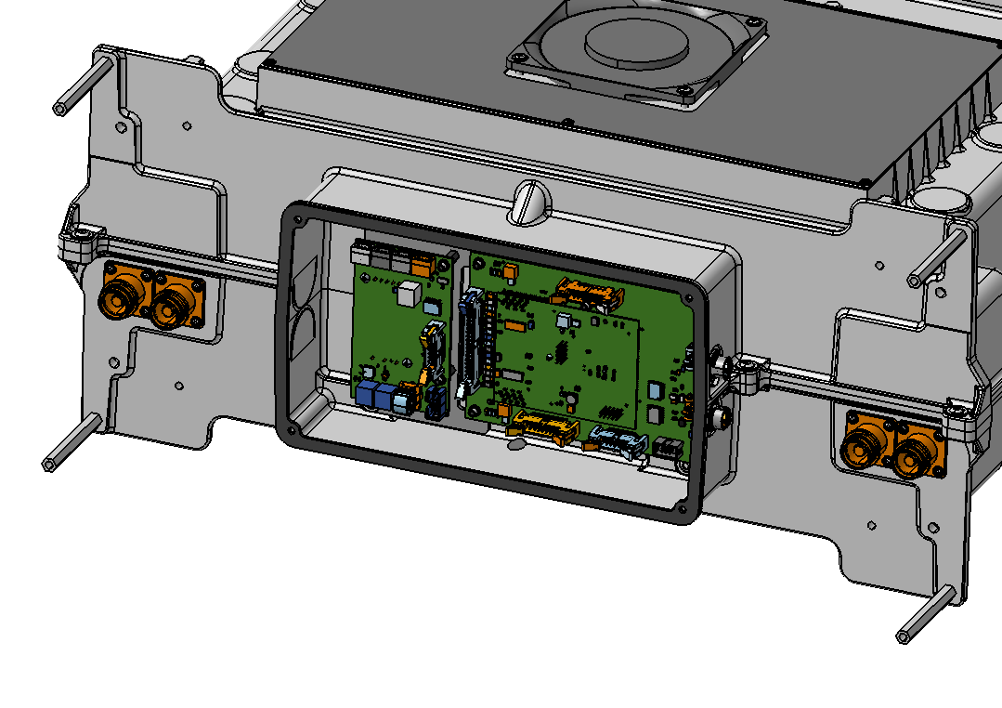
EST-FT REROUTE to ST010/ST030 after ST050
REROUTE BACK TO ST010/ST030 after ST050 for final assembly steps
EST-FT work flow
AGV Transports the battery pack housing to the work location, docks of the skid at FX01 and proceeds to the next assignment
The battery pack type is identified with scanner BY01 and work instruction is loaded on the information screen
Operator scans tray of exhaust cover, picks the part, and mounts it at specified location
Operator scans tray of PCB bracket sub-assy, picks the part, and mounts it at specified location
Operator scans trays of stand-offs, picks the parts, and mounts them at specified location
3
4
5
5
2
1
3
4
5

Slide 51
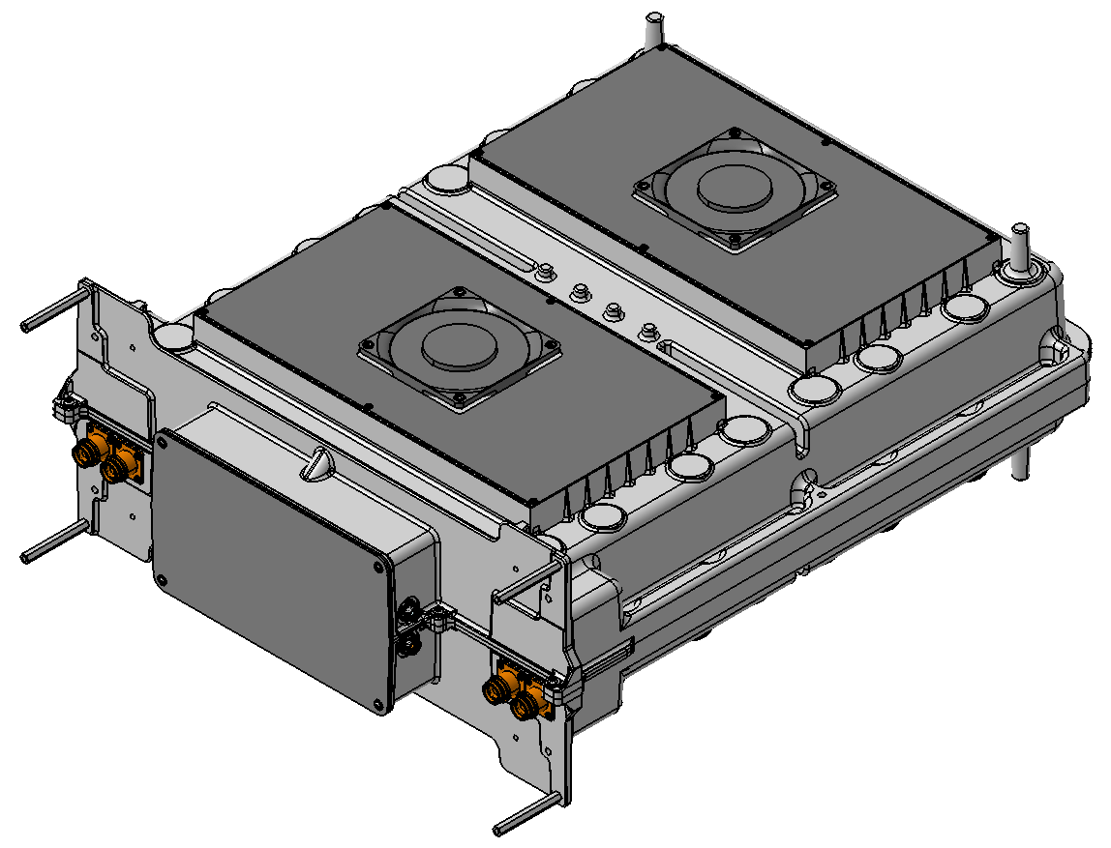
EST-FT REROUTE to ST010/ST030 after ST050
REROUTE BACK TO ST010/ST030 after ST050 for final assembly steps
EST-FT work flow
AGV Transports the battery pack housing to the work location, docks of the skid at FX01 and proceeds to the next assignment
The battery pack type is identified with scanner BY01 and work instruction is loaded on the information screen
Operator scans tray of exhaust cover, picks the part, and mounts it at specified location
Operator scans tray of PCB bracket sub-assy, picks the part, and mounts it at specified location
Operator scans trays of stand-offs, picks the parts, and mounts them at specified location
Operator scans tray of PCB cover gasket and plate, picks the parts, and mounts them at specified location
3
4
5
6
6
2
1
3
4
5
6

Slide 52
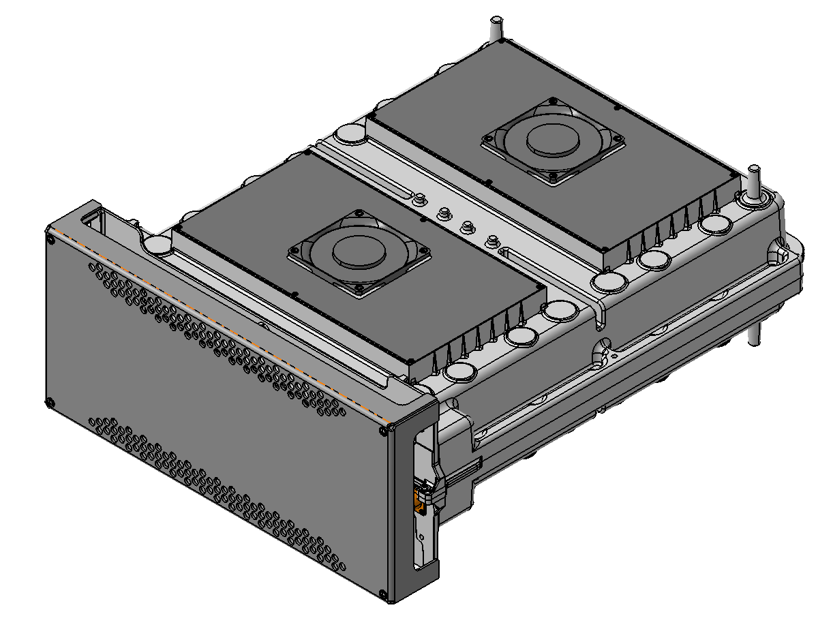
EST-FT REROUTE to ST010/ST030 after ST050
REROUTE BACK TO ST010/ST030 after ST050 for final assembly steps
EST-FT work flow
AGV Transports the battery pack housing to the work location, docks of the skid at FX01 and proceeds to the next assignment
The battery pack type is identified with scanner BY01 and work instruction is loaded on the information screen
Operator scans tray of exhaust cover, picks the part, and mounts it at specified location
Operator scans tray of PCB bracket sub-assy, picks the part, and mounts it at specified location
Operator scans trays of stand-offs, picks the parts, and mounts them at specified location
Operator scans tray of PCB cover gasket and plate, picks the parts, and mounts them at specified location
Operator scans tray of cover, picks the part and mounts it at specified location
3
4
5
6
7
7
2
1
3
4
5
6
7

Slide 53
EST-FT REROUTE to ST010/ST030 after ST050
REROUTE BACK TO ST010/ST030 after ST050 for final assembly steps
EST-FT work flow
AGV Transports the battery pack housing to the work location, docks of the skid at FX01 and proceeds to the next assignment
The battery pack type is identified with scanner BY01 and work instruction is loaded on the information screen
Operator scans tray of exhaust cover, picks the part, and mounts it at specified location
Operator scans tray of PCB bracket sub-assy, picks the part, and mounts it at specified location
Operator scans trays of stand-offs, picks the parts, and mounts them at specified location
Operator scans tray of PCB cover gasket and plate, picks the parts, and mounts them at specified location
Operator scans tray of cover, picks the part and mounts it at specified location
Quality check for the applied work
Operator releases the skid for pickup by AGV by pushing the release button or if NOK scans error barcode.
AGV drives into the station, picks up the skid at FX01 and transports battery pack to the next station
3
4
5
6
7
9
10
2
8
1
9
3
4
5
6
7

Slide 54
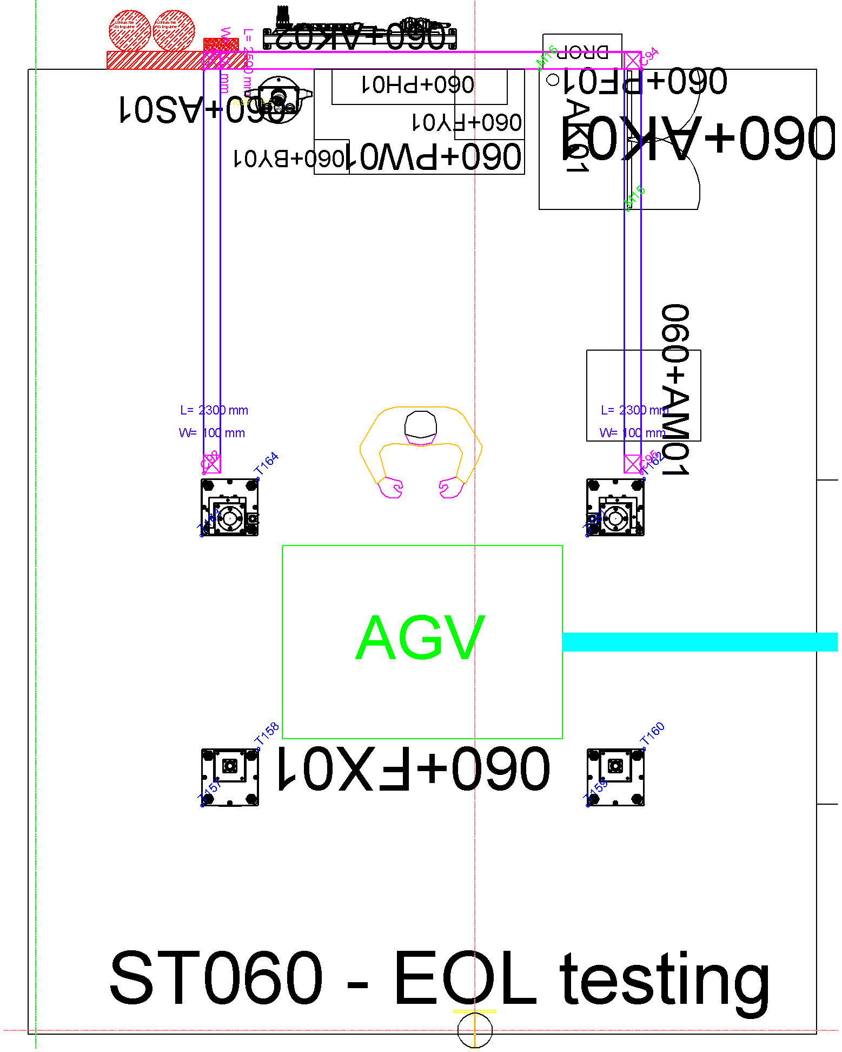
ST060 End-Of-Line testing EST-FT
EST-FT work flow
AGV Transports the battery pack housing to the work location, docks of the skid at FX01 and proceeds to the next assignment
The battery pack type is identified with scanner BY01 and work instruction is loaded on the information screen
Operator connects the test equipment (leak-test) and starts the test program
Operator disconnects the test equipment when test program has ended
Operator prints and applies stickers/labels to battery pack
Operators release the skid for pickup by AGV by pushing the release buttons or if NOK scans error barcode. Small repairs will be done in the station and large repairs in the rework station.
AGV drives into the station, picks up the skid and transports battery pack to the next station and if NOK to the rework station
6
5
2
3
4
1
7

Slide 55

ST060 Fault handling

Slide 56
ST060 Data logging
Cycle time logging:
To monitor cycle time, the timestamp will be logged at the following moments:
Skid is docked off
Process step is completed
Skid is released for transport
Skid is loaded
Process data logging:
All test parameters and results

Slide 57

ST900 Rework
Work flow
AGV Transports the battery pack housing to the work location, docks of the skid at FX01 and proceeds to the next assignment
Operator reworks or repairs battery pack
Operator scans code with scanner BY01 to indicate where the battery pack needs to re-enter the production line
Operator releases the skid for pickup by AGV by pushing the release button
AGV drives into the station, picks up the skid at FX01 and transports battery pack to the next station
N.B. Product to be reinserted directly after a production batch of the same product type to ensure material is present and the correct tooling is already on the robots
4
2
3
5
1

Slide 58

ST900 Fault handling

Slide 59
Service Processes (To be further determined)
Adhesives inspection
Automatic adhesive inspection with Quiss vision system
Calibration of the camera with calibration plate (once per month/crash/maintenance)
Periodic check of barrel expiration date (every x weeks)
Glue purge
How often / how much / decided by who?
Camera systems calibration / teach
Cognex ISD905, IS7600 and IS2800 calibrations
IR camera makes use of internal shutter to calibrate (robot is not allowed to move during use of shutter!)
Bolting system calibration
Periodic calibration by SAB?
Robots
Maintenance, cleaning
Tool check / gripper check
TCP check
Other
Maintenance, cleaning?

